Slide 1
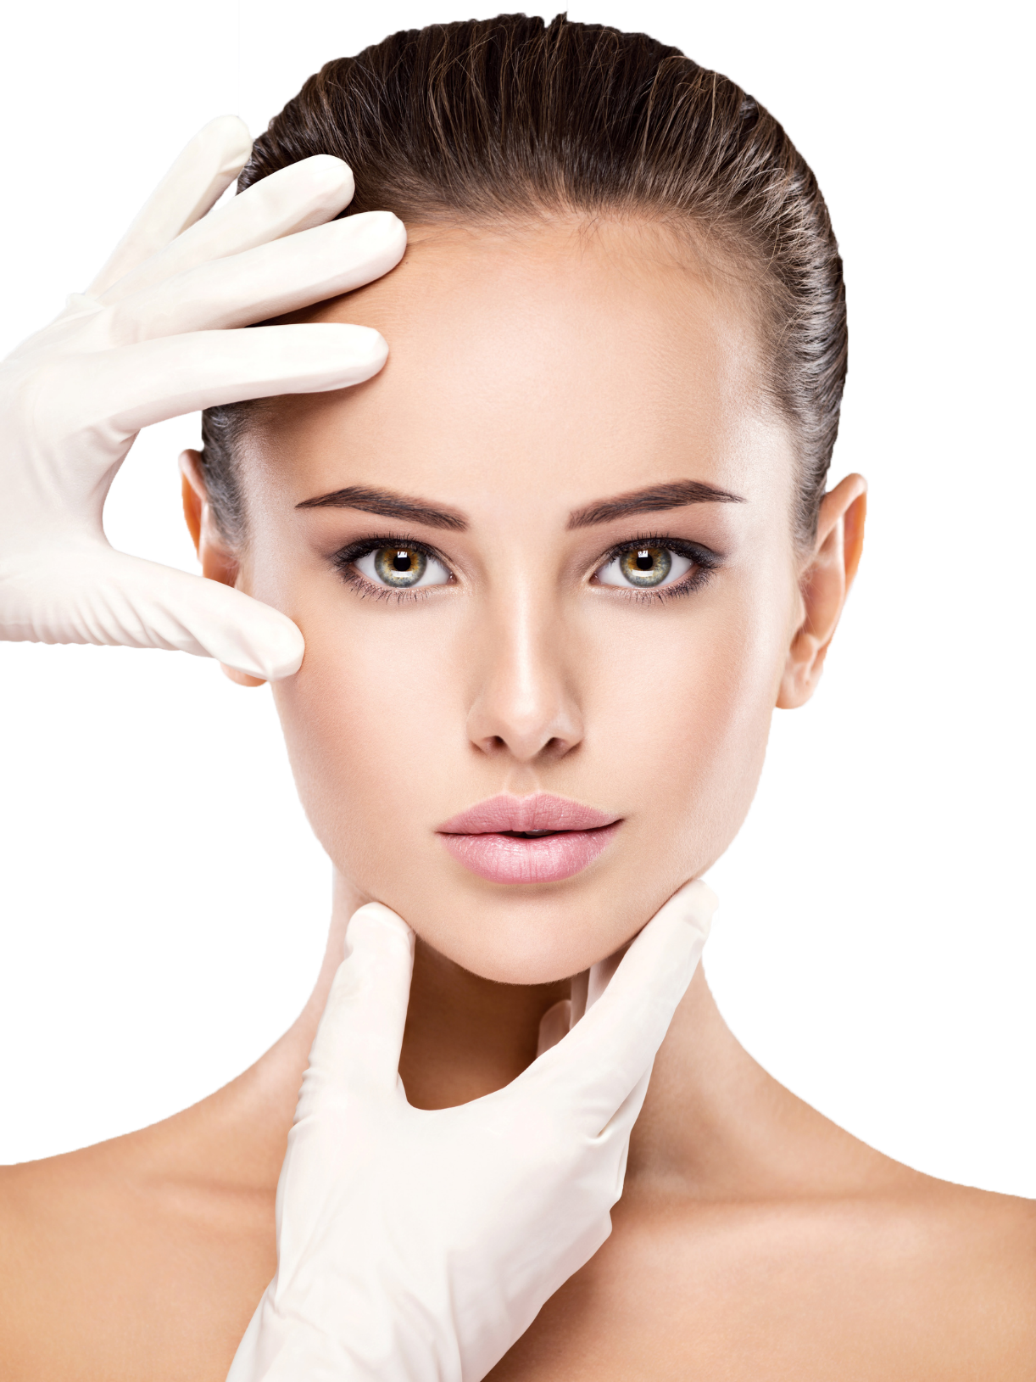

JETT PLASMA
Silver Tip
Lift & Tight
Elizabeth Moberg
Derma ProMedical

Slide 2
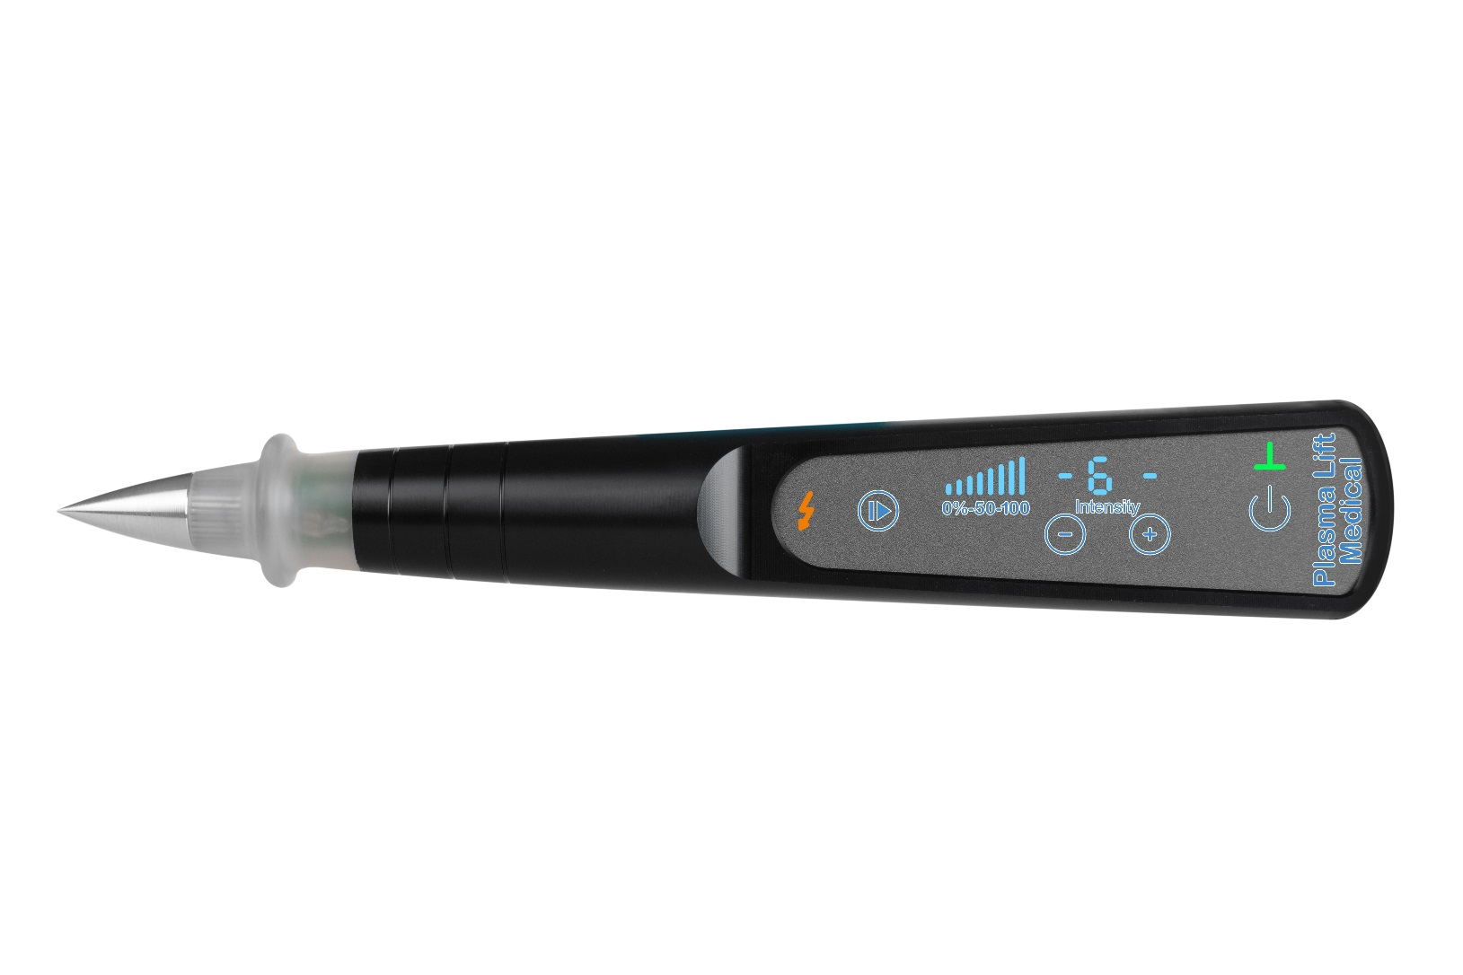
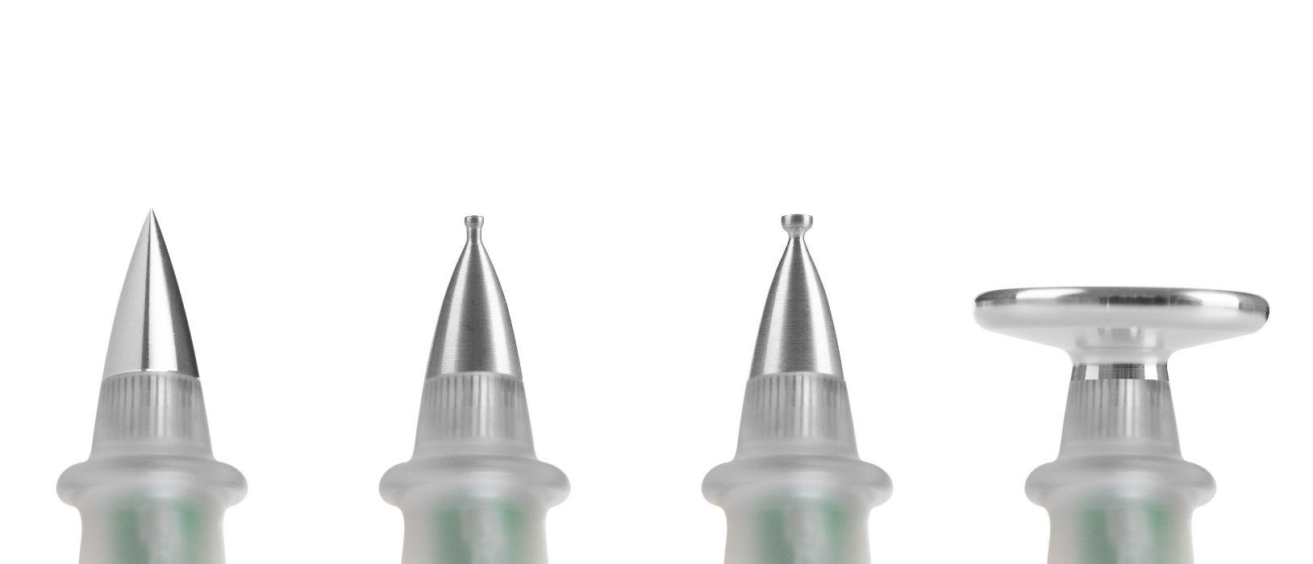
SILVER TIP Plasmic flow & Electrophorese
NON-ABLATIVE Stimulate • Prevent • Counteract • Maintain

Slide 3
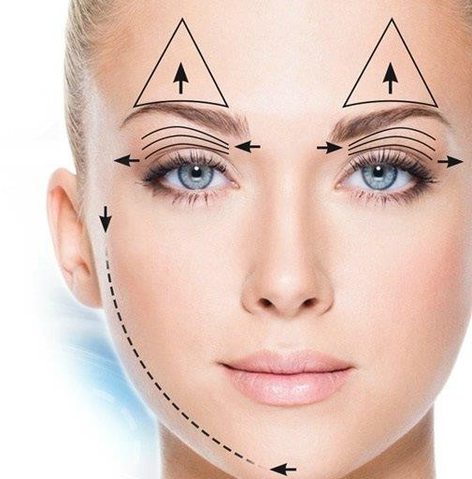
JETT PLASMA SILVER TIP
Skin Rejuvenation
Corrective treatment
Aging is a fact
A wish of eliminating unwanted age signs
Targeting: When aging is visible
Skin Revitalization
Stimulating treatment
Maintaining and preventing effects reducing age signs
Aging is not a fact
A wish of maintaining skin condition and counteract skin aging
Targeting: When aging is yet not visible and maintain treatment

Slide 4
JETT PLASMA SILVER TIP Benefits & Values
Benefits
Increased micro circulation - Improved nourishment and oxygenation
Depolarize the cell membrane potential - Rebalancing the potassium & sodium cations
Cosmetic impacts
Electrophorese
Added value through increased penetration of active skin care
LIFT & TIGHT

Slide 5
SILVER TIP – ”MY WAY”…
Why I like to recommend JETT Plasma Silver
Fast and nice way for skin improvements
Highly tolerated on all skin types
All-year-around treatment
Now down-time
Immediate and long-term results
1+1=3 Together better than stand-alone
Can be combined with other treatments for increased “co-operating” results - Chemical Peels, Microneedling, PRX-T33, LED-lights, etc.
Add-on value to classical facials, etc. - Increased and long-term results

Slide 6
SILVER TIP – ”MY WAY”…
Lift & Tight - Special areas - Eyes and mouth
Treatment protocol
- 6 treatments - 4 days between session 1-2 - 7 days between 2-6 - Recommended maintain treatment every 6-8 weeks
Products used in treatment - JETT Vital & Ultrasound gel
Homecare products - TEBISKIN Gly Clean, Sod C, Reticap E&L, Reticap Face day care, EGF night care

Slide 7

SILVER TIP – MY WAY
The performance…
https://youtu.be/tLX2MbPy6kI

Slide 8
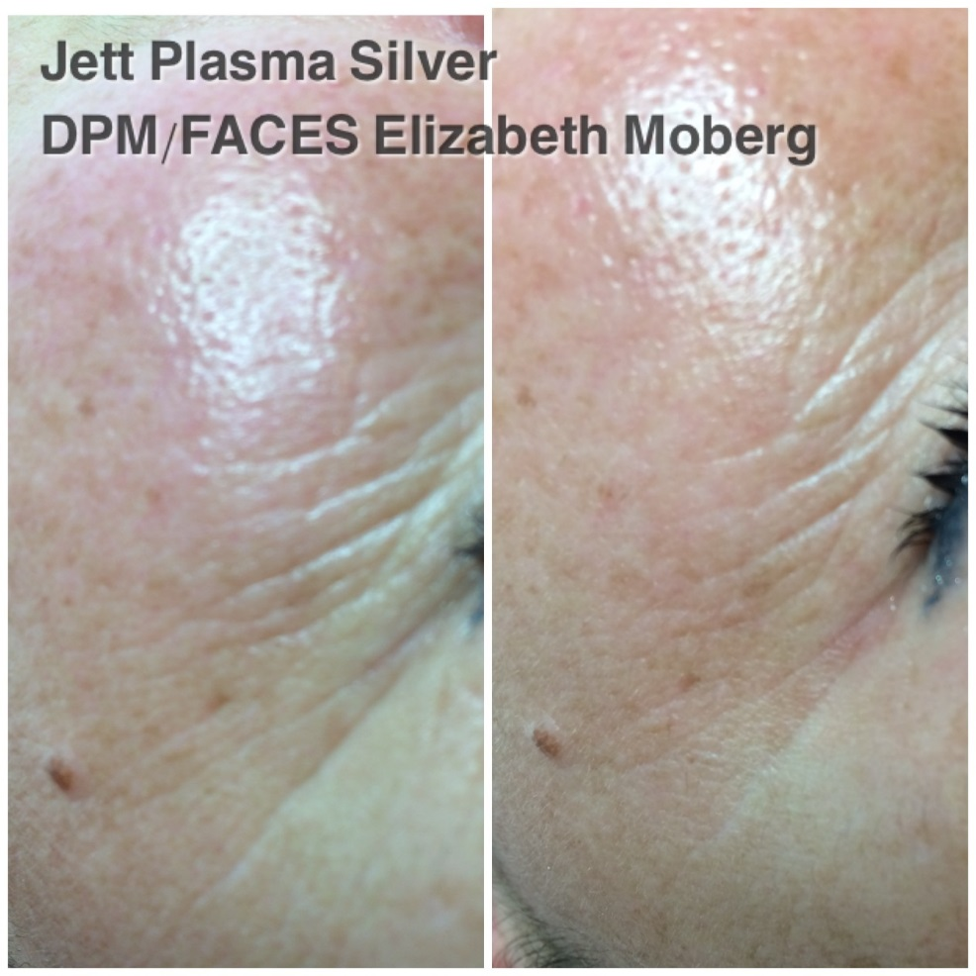
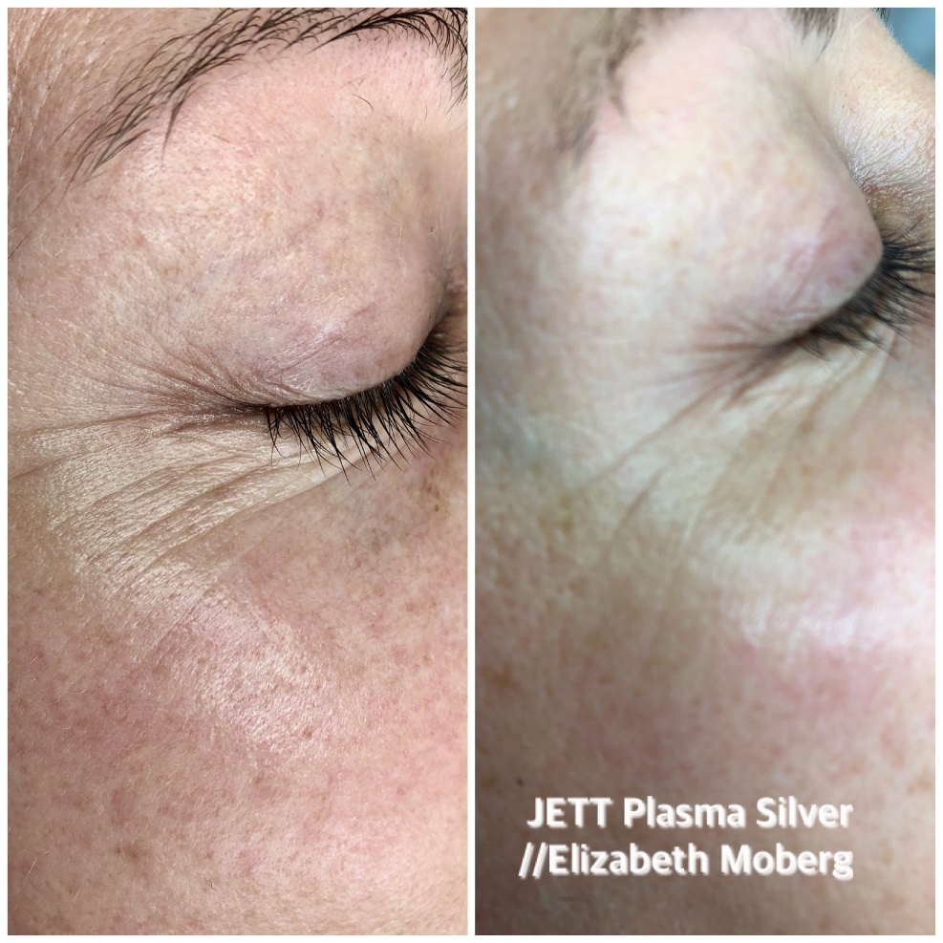

BEFORE & AFTER

Slide 9
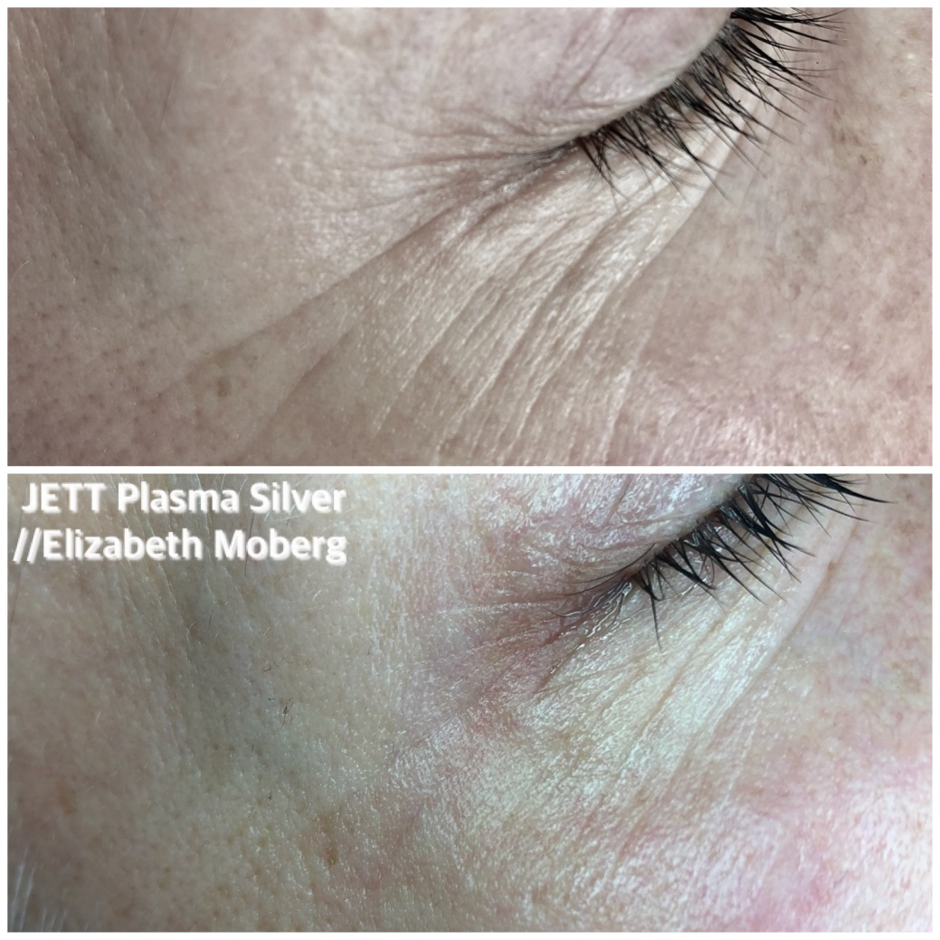
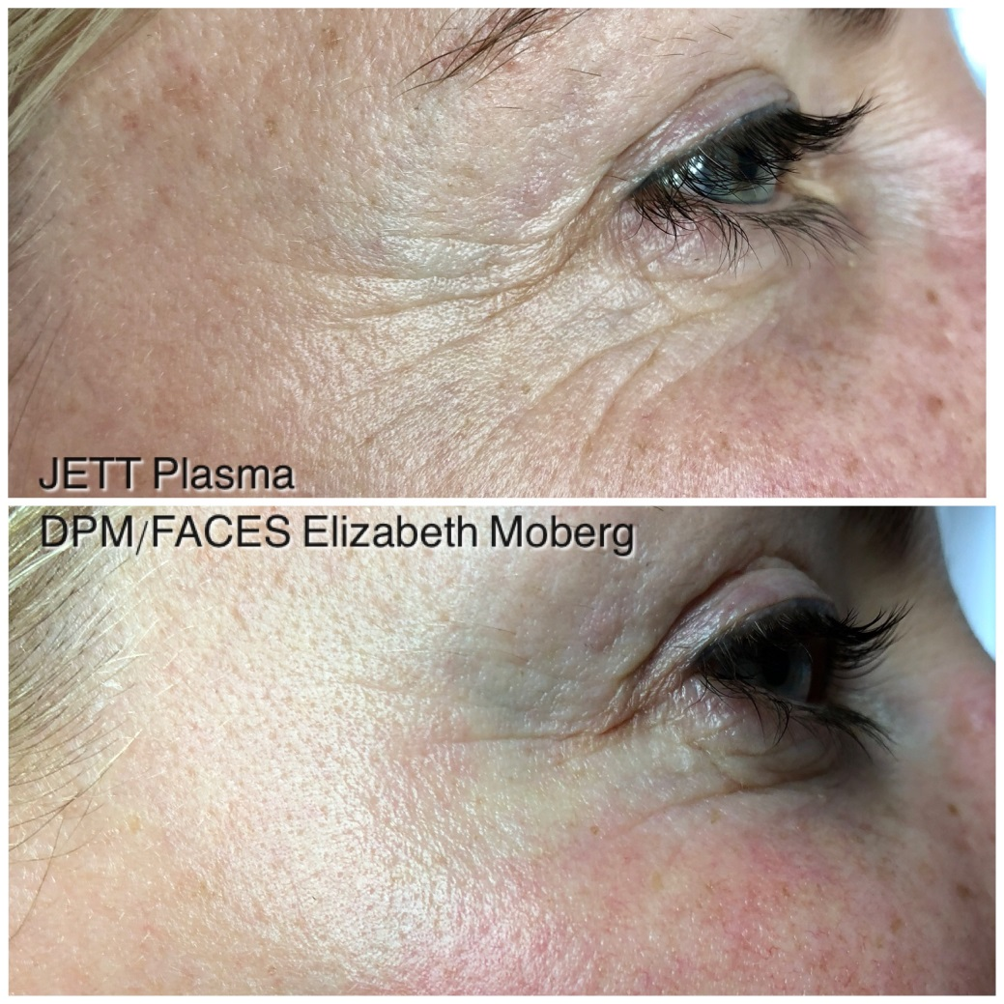
BEFORE & AFTER

Slide 10
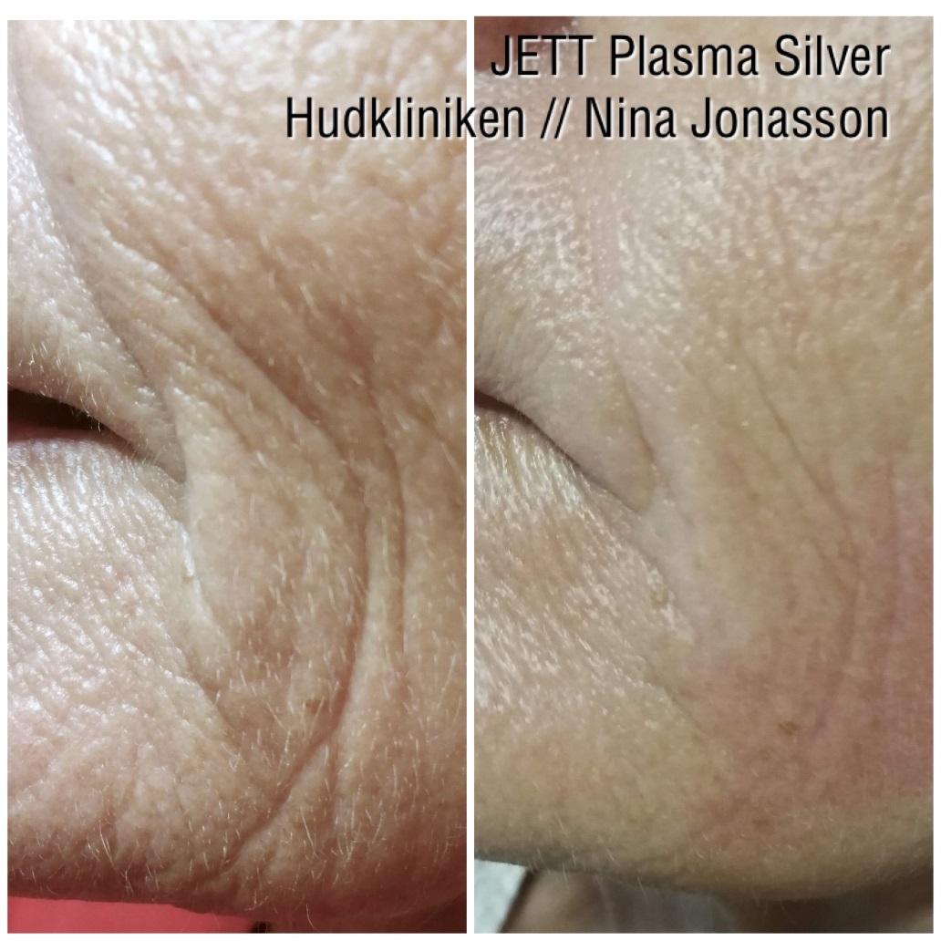
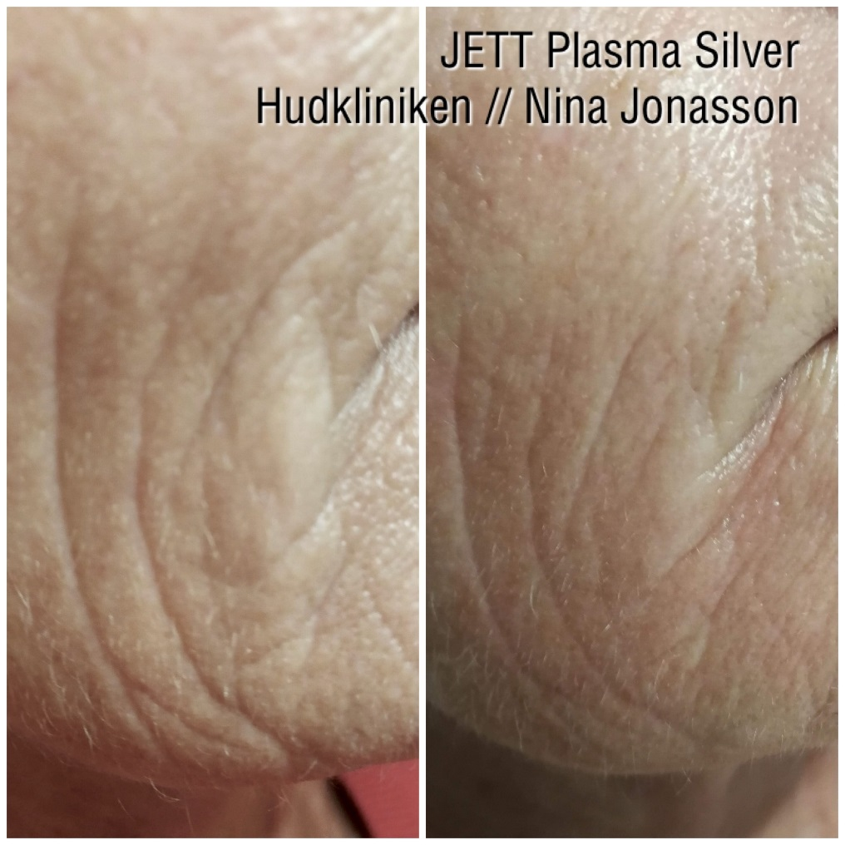
BEFORE & AFTER

Slide 11
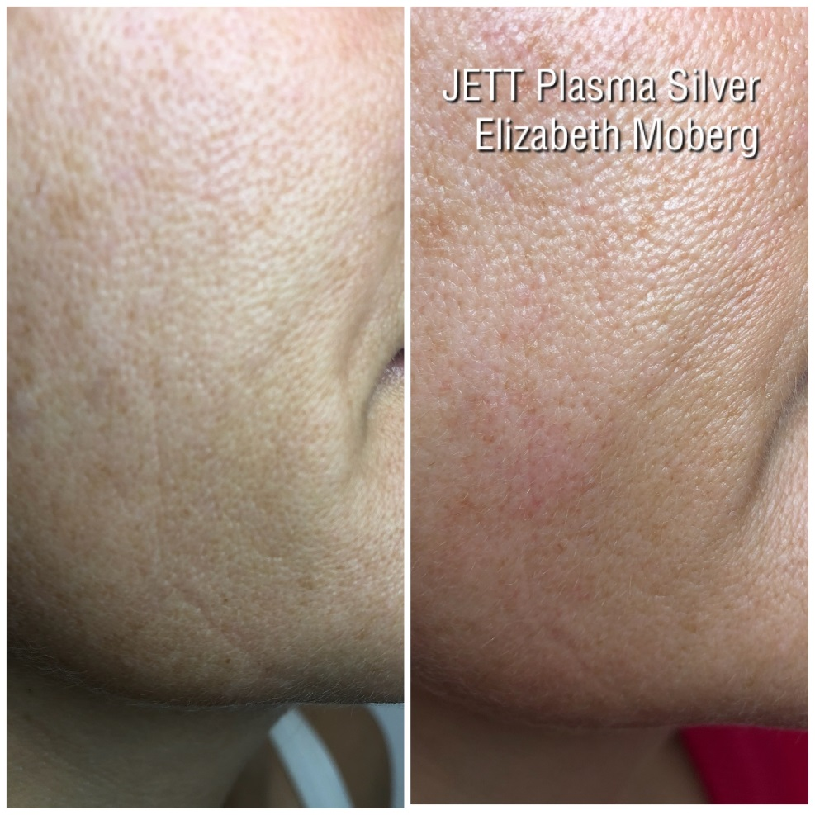
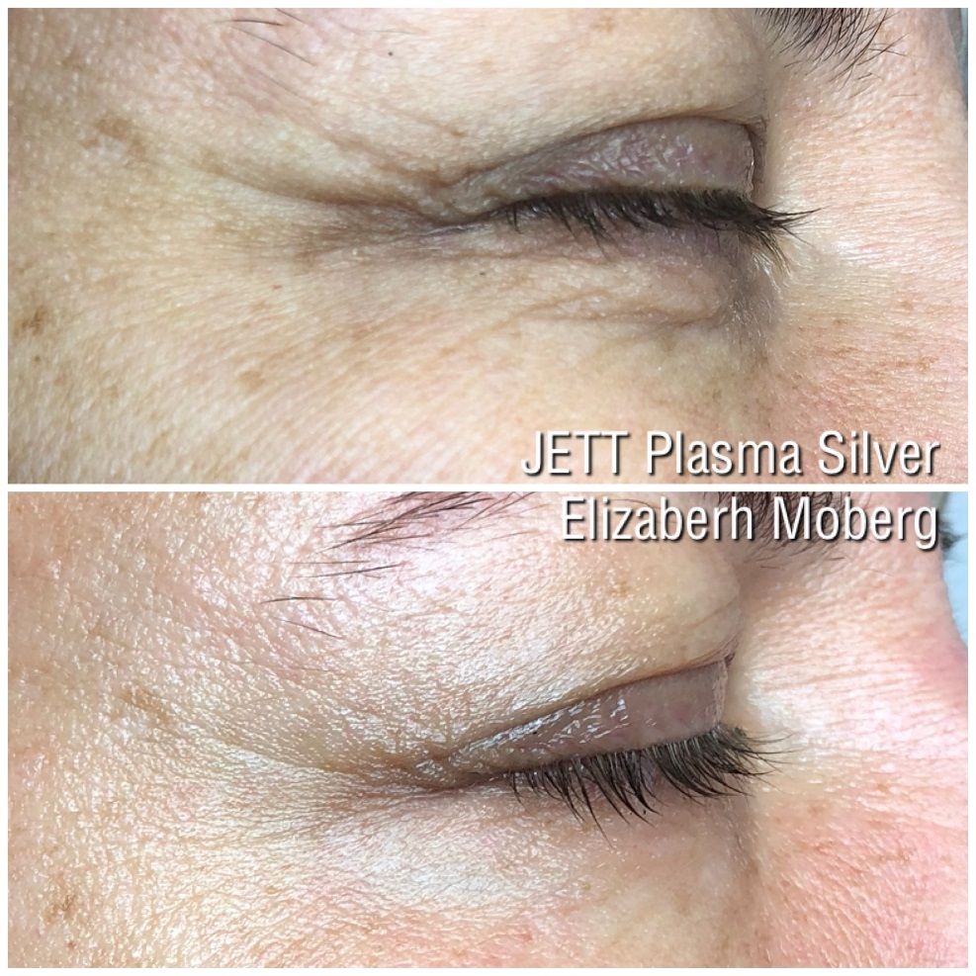
BEFORE & AFTER

Slide 12
JETT PLASMA
Silver Tip
1 + 1 = 3

Slide 13
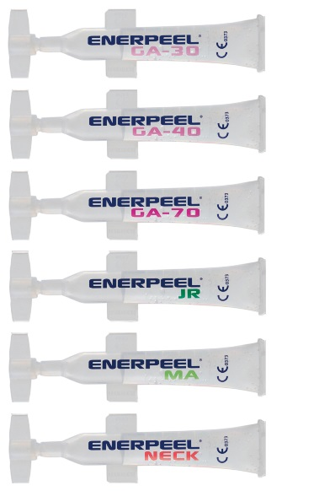
COMBINED TREATMENTS Chemical Peeling
Benefits (catabolic action)
Removes str. Corneum/dead cells
Softens/improving epidermal structure
Softens hyper keratinization
Reduces minor imperfections
Immediate smooth look
Benefits (anabolic action)
Stimulates epidermal and dermal functions - Increased cell turn over - Collagen - Hyaluronic Acid, etc.
Reduces minor discolors - Hyper pigmentations
Stimulates growth factors - EGF Epidermal growth factor - FGF Fibroblast growth factor - PDGF Platelate derived growth factor - KGF Keratinocyt growth factor
Promotes collagen stimulation for improved firming action

Slide 14
COMBINED TREATMENTS Chemical Peeling
Recommended substances
Glycolic Acid Improved collagen, Hydration
Mandelic Acid Improved collagen, Hydration, Anti-inflammatory
Jessner’s Peel Hyper pigmentations, Rejuvenating action (1-6)
Pyruvic Acid Superficial hyper pigmentations, Oily skin
Protocols
Perform JETT Plasma Silver Tip (pre) post Chemical Peels
Single application or repeated due to need (4-6 weekly sessions)

Slide 15
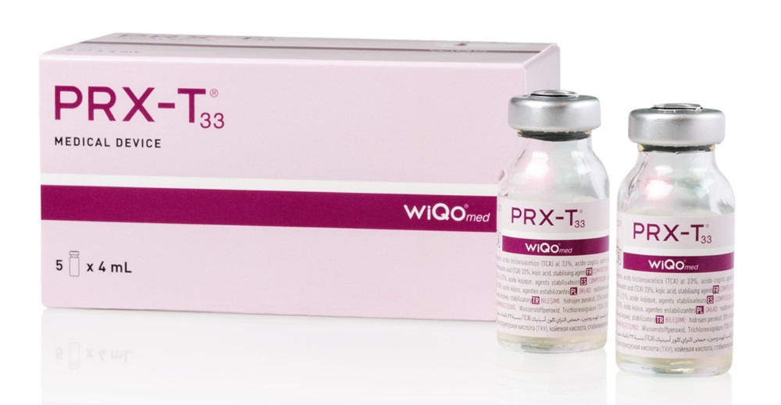
COMBINED TREATMENTS PRX-T33 (No-needle biorevitalization)
Benefits
Immediate improved firmness and “plumping” effect
Deep hydration
Collagen stimulation
Stimulates cell turn over and renewal
Stimulates growth factors
Protocols
Perform JETT Plasma Silver pre PRX-T33 (Gold Tip post PRX-T33)
Single application or repeated due to need (4-5 weekly sessions)
NOTE! – only post silvertip, important to maintain correct ph-value after prx-t33

Slide 16
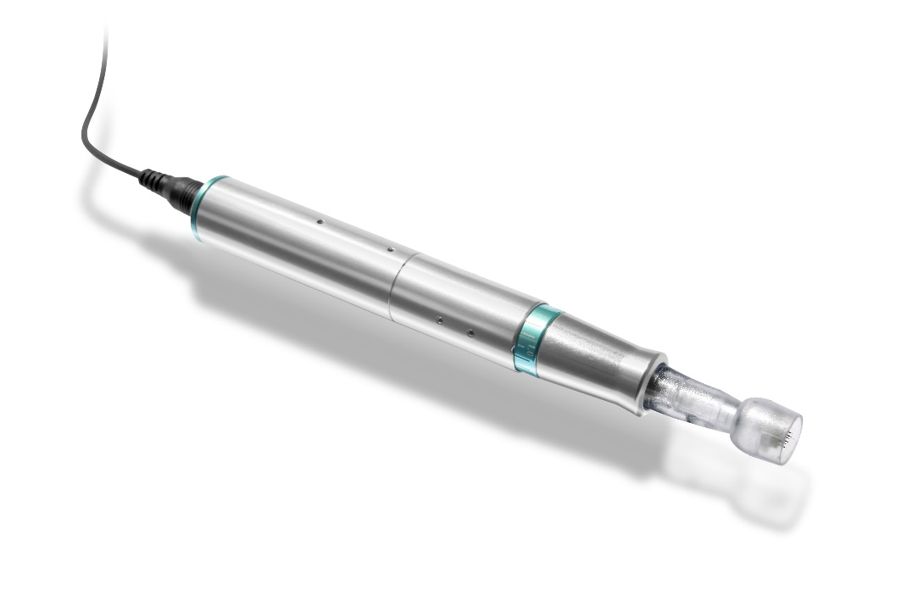
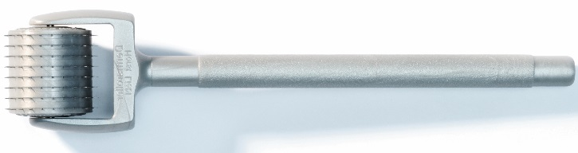
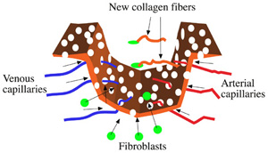
COMBINED TREATMENTS Microneedling
Benefits
Neo-collagenesis for improved collagen stimulation - Complementary deep firming action for wrinkle reduction
Neo-angionesis for improved vascular sun damages - Normalizing properties of vascular structure
Improves uneven skin tones
Protocols
Perform JETT Plasma Silver Post Microneedling
Single application or repeated due to need (3 sessions every 4 weeks)

Slide 17

QUESTIONS?

Slide 18


Thank you for your attention!
Sweden
Elizabeth Moberg CEO Derma ProMedical
www.dermapromedical.se

