Slide 1
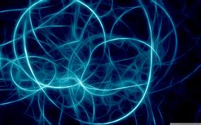
Plasma
Jana Kopuletá

Slide 2
GAS
is comprised of neutral atoms or molecules
inside appear collisions of atoms,ions and electrons
- non-flexible collisions
- inner energy changes
NON-FLEXIBLE COLLISIONS CAUSE IONIZATION, EXCITATION, DEEXCITATION AND RECOMBINATIONS OF IONS AND ATOMS IN THE GAS

Slide 3
Townsend avalanche theory
it describes the aforementioned collisions
avalanche effect in gas subject to ionising radiation between two plate electrodes
the original ionisation event liberates one electron, and each subsequent collision liberates a further electron, so two electrons emerge from each collision to sustain the avalanche

Slide 4
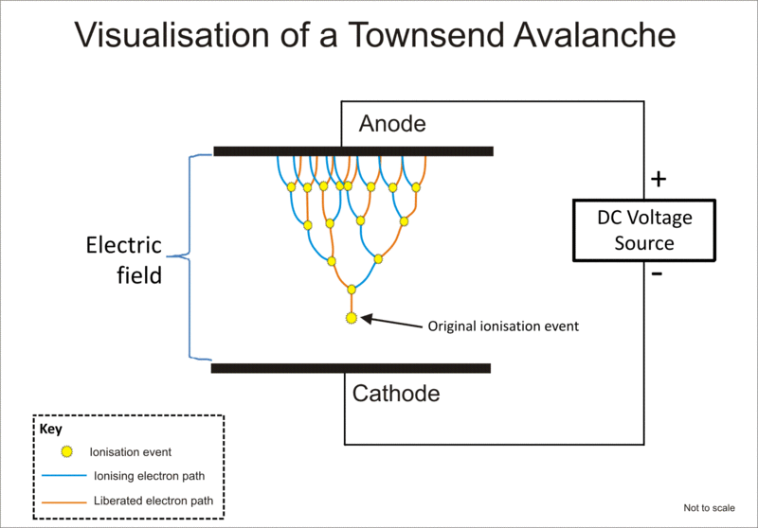

Slide 5
the result is an avalanche multiplication that permits electrical conduction through the gas
the discharge requires a source of free electrons and a significant electric field; without both, the phenomenon does not occur

Slide 6
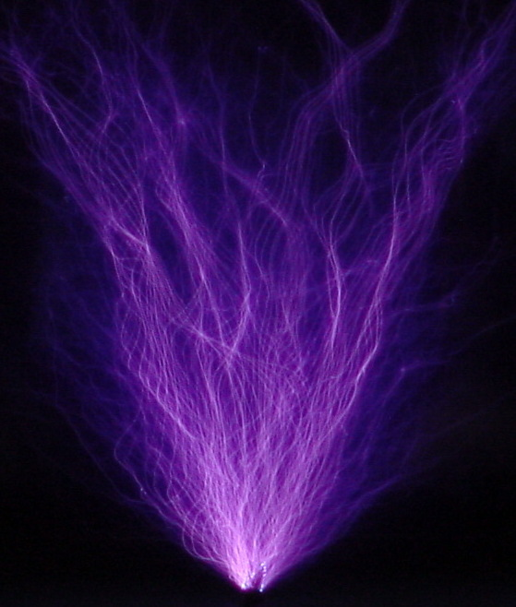
Discharges in gas
In the atmospheric or decreased pressure may apper:
ARC discharge – high current, lower voltage, high temperature
CORONA discharge – is created in a strong non-homogenous electric field
SPARKLE discharge – high currents through a smaller section, short lasting
SMOLDERING electric discharge –low current, low temperature

Slide 7
Plasma
ionized gas, which is created in any discharges
was discovered in 1923 by Lagmuir
is comprising of ions, electrons and neutral particles and molecules
is created by unbounding of electrons
from the electron shell of atoms of gas
or
by the tearing of molecules = ionization

Slide 8
Paschen´s law
is an equation that gives the breakdown voltage Uᵨᵣ, that is the voltage necessary to start a discharge or electric arc, between two electrodes in a gas as a function of pressure and gap length
Uᵨᵣ = f.(p.d)
f…constant
p…pressure d…distance between anode and cathode

Slide 9
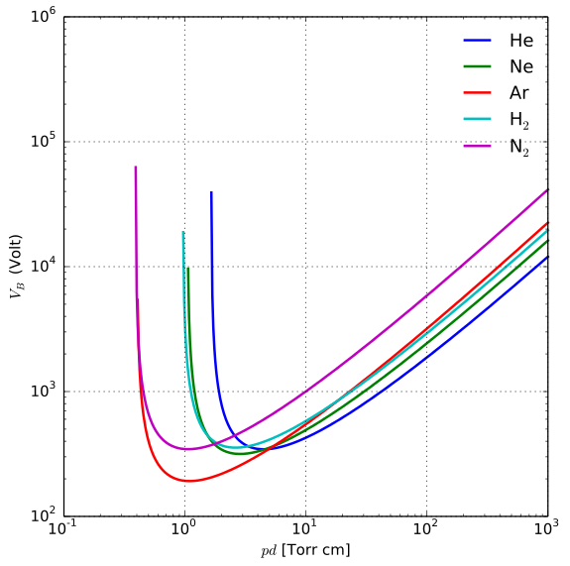

Slide 10
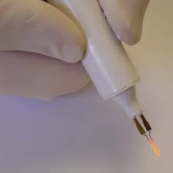
Electrocauteries
the first thermal effects of DC was described in the half of the 18th century by Benjamin Franklin and John Wesley
DC current conducted through a conductor to effectively cauterize the tissue in the place of contact was used at the beginning of the 19th century

Slide 11
The effects of the heat on the tissues
50 – 60 °C | Cell death in approximately 1-6 minutes
60 °C | Immediate cell death
60-65 °C | Coagulation appears
65-90 °C | Denaturation of proteins
90-100 °C | Drying (desiccation) appears
Over 100 °C | Leads to vaporization

Slide 12
Heating of tissues by sparkle discharge
Fulguration
-the falling sparkles carry thermal energy, which leads to the increase of intracellular cell temperature
-this is process, in which tissues are destroyed without incision
-these tissues coagulate superficially with a continually repeating high-voltage sparkles with low current force

Slide 13
2. Coagulation
-blood tissues are heated quickly during the flow of the current
-it leads to the denaturation of proteins and subsequent halting of bleeding
3. Desiccation
-intracellular liquid inside cells is heated
-it leads to the evaporation of water inside cells and to the drying of cells
4. Vaporization
-the water from cells is vaporize due to the passage of electric current

Slide 14
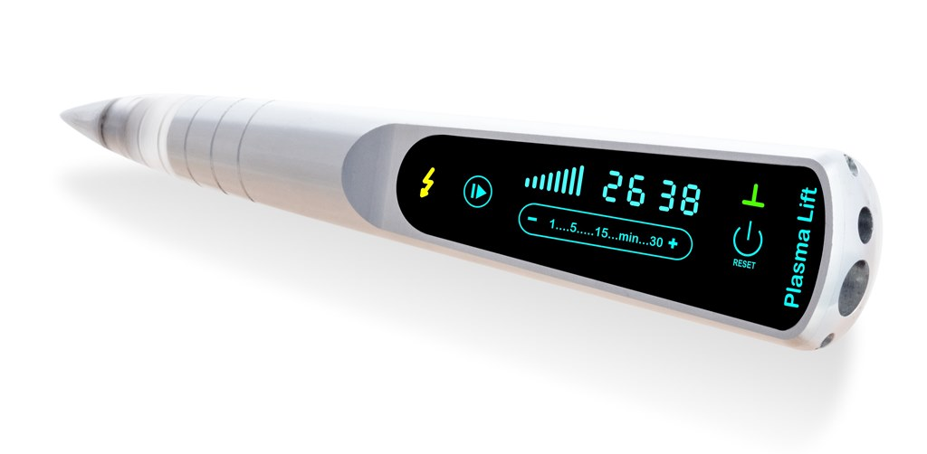
Jett Plasma Lift Medical
in the evaluated device is used DC fulguration
monopolar fulguration, during which a patient is conductively connected to the device by electrode
max voltage is 7000 V
max current is 1 mA
max power is 1,8 W

Slide 15
the best outcome is reached in the 50-60% of current

Slide 16
Manufacturer | Compex ltd.
Country of origin | Czech Republic
Type of device | Jett Plasma Lift Medical
Therapeutic principle of the device | Plasma discharge in combination with thermal energy, contactless application (electrode does not touch tissues)
Aim of use | Minor dermatological and surgery interventions
Working voltage | 0,8 – 7 kV
Mechanical design of the device | Compact design, everything in one device, the size of a pencil electrode
Voltage of the plasma discharge generator | 0,4 to 1,8 W 1 pencil electrode covers the whole range of the plasma discharge generator voltage
Detection of the grounding function | SCS Systém
Power supply | Power source – Power adapter
Size of handle | Length 24,5 cm, diameter 4,5 cm
Weight | Approx. 350 g

Slide 17
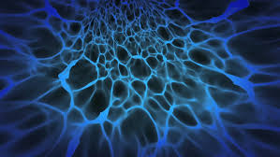
Thank you for your attention !

