Slide 1

Use of JETT Plasma Lift Medical in DERMATOLOGY
Liba Krejzlikova
Business Development & Marketing Manager

Slide 2

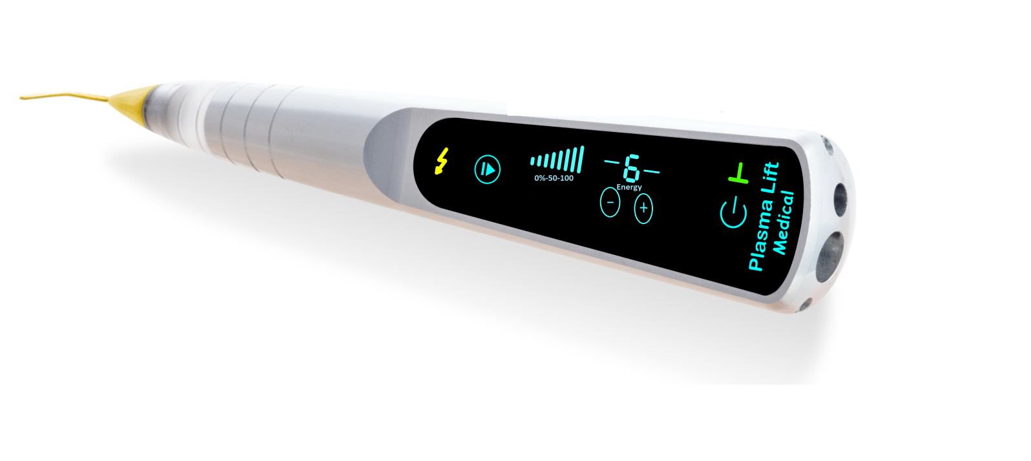
Use of JETT Plasma Lift Medical in DERMATOLOGY
str. 02/03
JETT Plasma Lift Medical
ETT Plasma Lift Medical is a smart portable DC (direct current) electric plasma

Slide 3
Use of JETT Plasma Lift Medical in DERMATOLOGY
str. 02/03
Plasma
Electric plasma is a ionized gas in the air (containing free electrons), created by high voltage about 5000 V, which is between the tip of the device and skin of a patient and maintaining distance of 1-2mm

Slide 4
Use of JETT Plasma Lift Medical in DERMATOLOGY
str. 02/03
DC fulguration
The main effects are achieved with “a plasma discharge” generated by DC voltage
Plasma discharge generates heat & warms the skin
Generated sparks in AC fulguration (all competitors on the market) operate on a relatively big area about 3-5 mm2
Jett Plasma Lift Medical uses DC fulguration with the spark flow area of 0,1 mm2

Slide 5
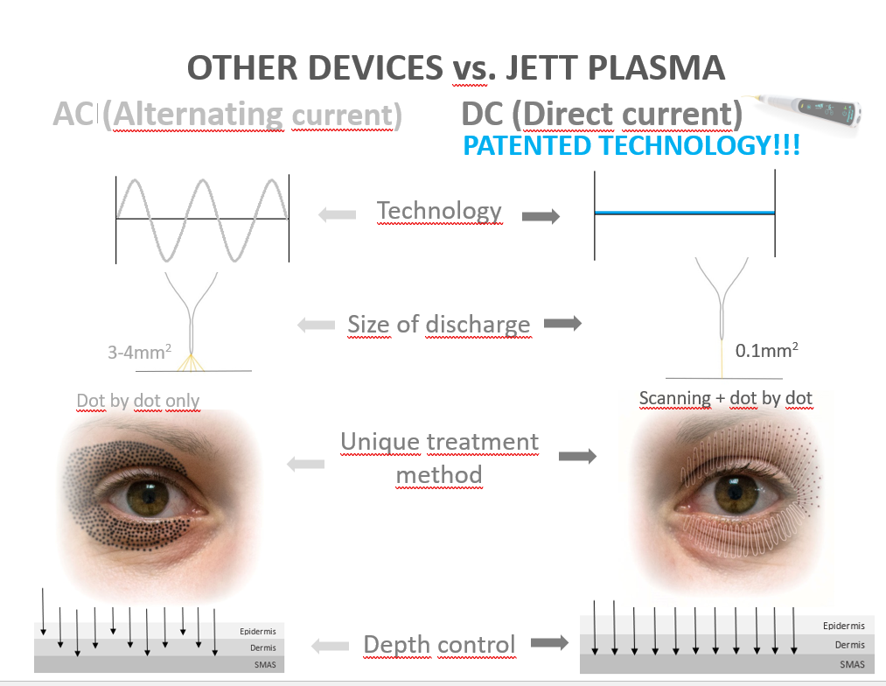
Use of JETT Plasma Lift Medical in DERMATOLOGY
str. 02/03
Direct current plasma technology
XXXX

Slide 6
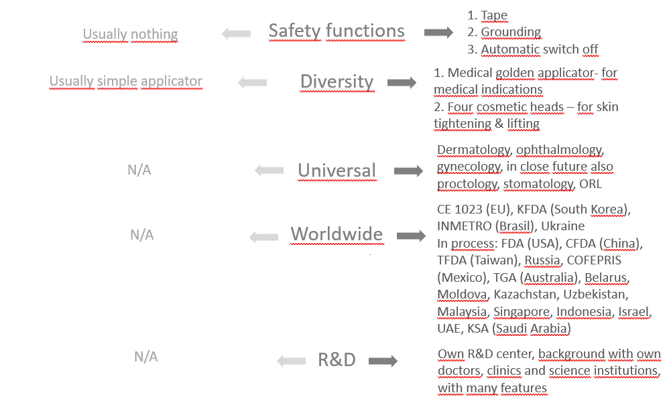
Use of JETT Plasma Lift Medical in DERMATOLOGY
str. 02/03
Direct current plasma technology
XXXX

Slide 7
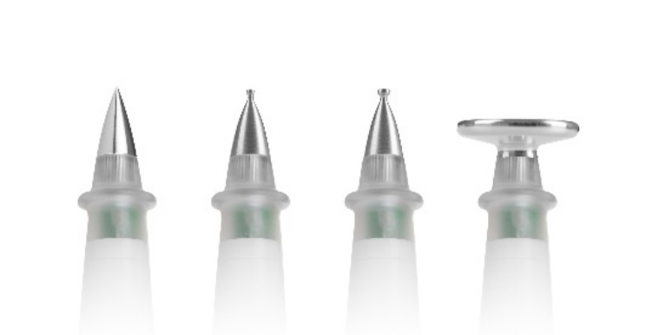
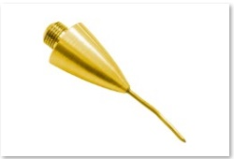
Use of JETT Plasma Lift Medical in DERMATOLOGY
str. 02/03
2 ways of JETT Plasma Lift Medical use
1. Contact treatment - silver applicators:
2. Contactless – golden applicator:

Slide 8
Use of JETT Plasma Lift Medical in DERMATOLOGY
str. 02/03
2 ways of JETT Plasma Lift Medical use
Contact treatment - silver applicators:
- Tingling, no burning
- No anaesthesia is needed
- Intensities 1-5
Every cell has a membrane potential. Inner side has a negative charge, the outer side has a positive charge. As the skin is ageing, the electric charge is distributed alternatively along the membrane, and the electric voltage of the membrane is changed.
Plasma is able to get the membrane potential back to equilibrium.

Slide 9
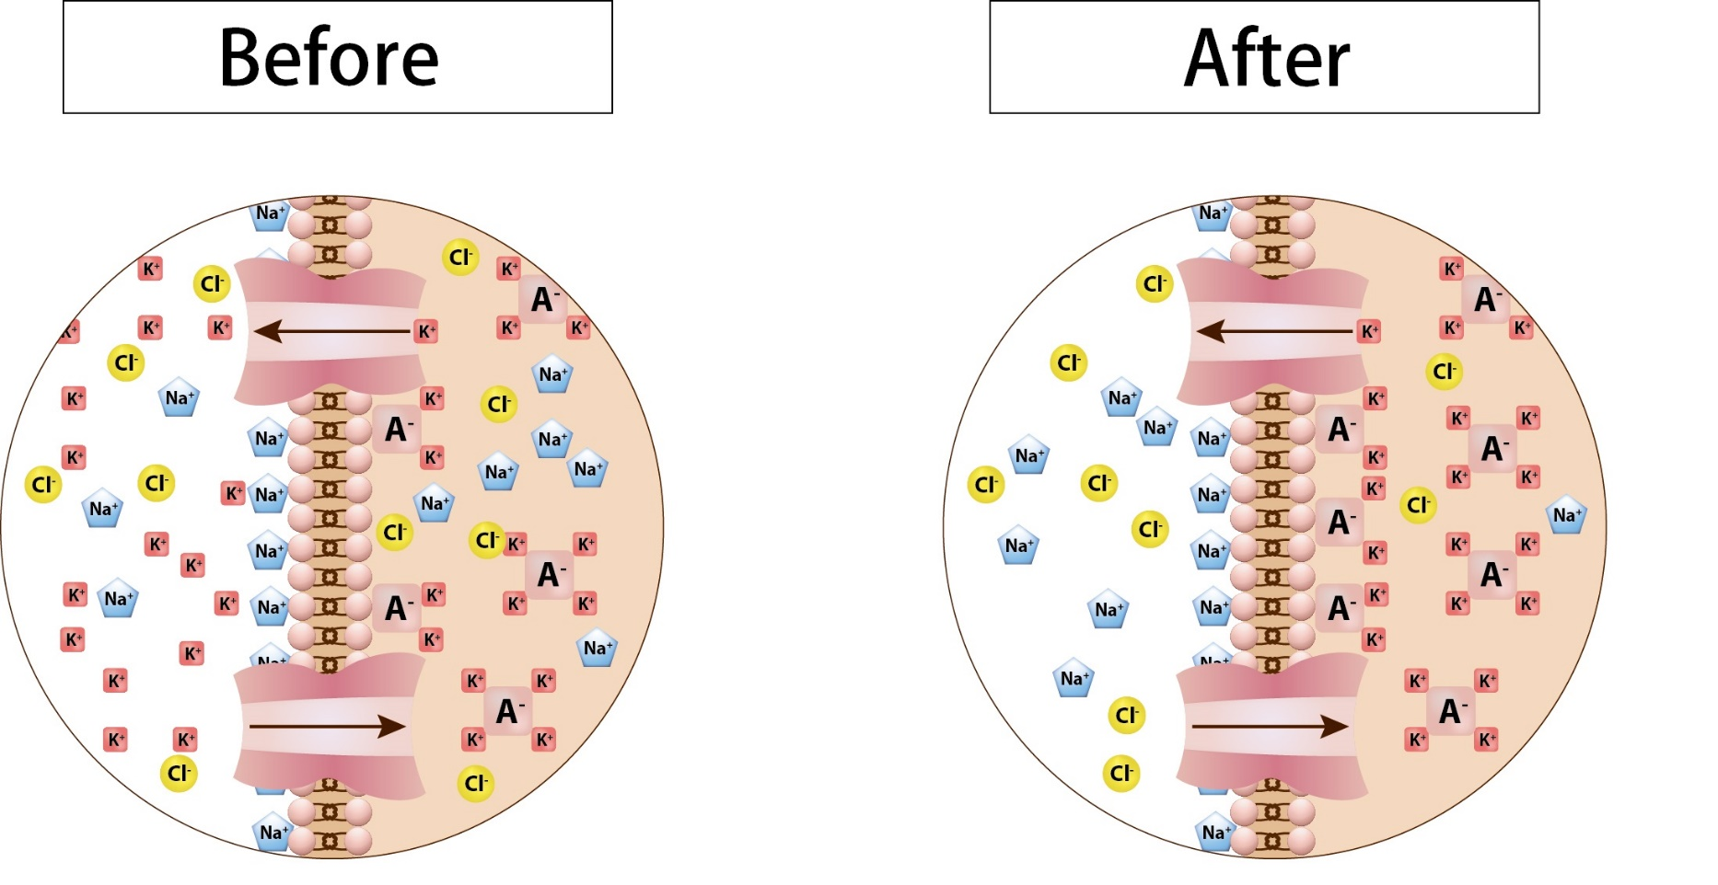
Use of JETT Plasma Lift Medical in DERMATOLOGY
str. 02/03
Silver applicators treatment
XXXX

Slide 10
Use of JETT Plasma Lift Medical in DERMATOLOGY
str. 02/03
2 ways of JETT Plasma Lift Medical use
Contactless – golden applicator:
- heating, burning - resurfation
- anaesthesia needed
- Intensities 6-8
- effect of plasma flows on tissues:
Scanning (continual movements) = superficial burn of the skin (like peeling)
Dot-by-dot (max 3 seconds at 1 place) = microtraumas in dermis, stimulates fibroblasts to produce collagen
Together: very effective peeling, tissue recovery, skin tightening, improvement of flexibility and stimulation of immunity and resistance of the tissues

Slide 11
Use of JETT Plasma Lift Medical in DERMATOLOGY
str. 02/03
Golden tip use
The highest intensities (6, 7 and 8) are able to destroy skin cells. The tip of the device can reach temperatures up to 80°C.
A relatively low electric power, at maximum 1.8 W is applied and as it affects only a small area, it is able to cause the evaporation of cell liquids.
High temperature causes coagulation of tissue and blood proteins, which is used for stopping a small bleeding – to closure of small veins (with a diameter of 2-3 mm.)
The discharge is applied with a smaller power (1.8 W), compared to common electrocauters

Slide 12
Use of JETT Plasma Lift Medical in DERMATOLOGY
str. 02/03
Indications
angioma senilis
verrucae seborrhoicae
verrucae plane
angiokeratoma
teleangiectasis
lentigo
fibroma molle
keratoacanthoma

Slide 13
Use of JETT Plasma Lift Medical in DERMATOLOGY
str. 02/03
Indications
condyloma accuminata
moluscum contagiosum
verrucae vulgares
verrucae filliformes
naevus capillaris
naevus arraneus
keratosis actinica
keratosis senilis
keratosis seborrhoica

Slide 14
Use of JETT Plasma Lift Medical in DERMATOLOGY
str. 02/03
Types of treatment
Superficial and deep wrinkles
Small warts
Fibromas and hemangiomas
Couperosis (dilated vessels) – for closing vessels
Pigment spots
Scars
Bleeding/ capillary bleeding/ after a minor surgery/ stops bleeding

Slide 15
Use of JETT Plasma Lift Medical in DERMATOLOGY
str. 02/03
Contraindications
Pacemaker, Holter blood pressure monitoring system or ECG
Other implanted electrical device
Epilepsy
Pregnancy
Metal implants in the treatment area
Skin problems, inflammation diseases - erysipelas
Oncological disease
Other non-controlled or hardly-controlled disease

Slide 16
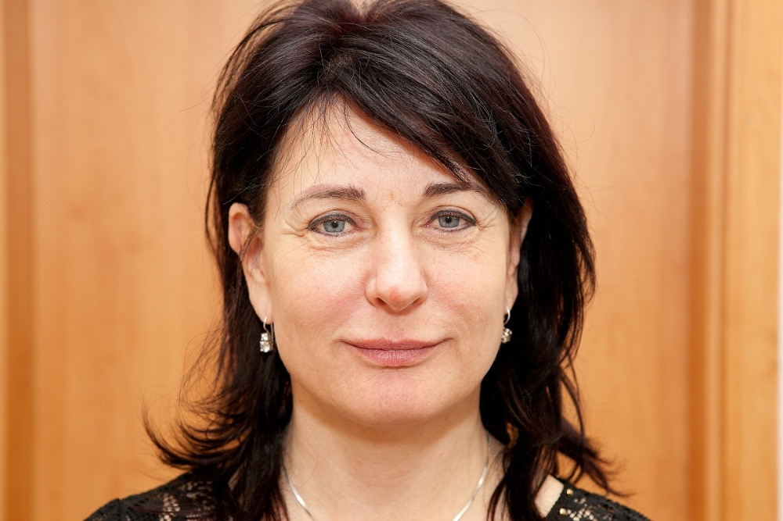
Use of JETT Plasma Lift Medical in DERMATOLOGY
str. 02/03
Case interpretation
50 years old patient
after surgical blepharoplasty 6-7 years ago
main problem: superficial and deep wrinkles around the eyes

Slide 17
Use of JETT Plasma Lift Medical in DERMATOLOGY
str. 02/03
Protocol of treatment (EUROPE)
Before
Informed consent
Contraindications
desinfection
local anaesthesia without vasoconstriction part like epinephrin etc.
treating upper and lower eye lid – scanning 5-7 min. to visible flush or erythema

Slide 18

Use of JETT Plasma Lift Medical in DERMATOLOGY
str. 02/03
Protocol of treatment
erythema means warming dermis and starts tissue recovery, its tightening, improvement of flexibility and it also stimulates immunity and resistance of the tissues
apply dot-by-dot only on upper eye lid – deeper damage of the skin
contraction of collagen

Slide 19
Use of JETT Plasma Lift Medical in DERMATOLOGY
str. 02/03
After treatment
skin is disinfected by the doctor / therapist after the treatment.
Immediately after treatment apply one of healing creams (e.g. “cica” cream) which contain panthenol and hyaluronic acid and are suitable to be applied to injured and irritated skin and accelerate reparation of epidermis.
disinfect the treated area twice a day after washing for 7-10 days after the procedure and after that always apply healing cream. This procedure has to be repeated until the spontaneous separation of crusts.
corrective cosmetics can only be used after healing of the epidermis / if necessary, Oxygenetix cover breathable products can be used.
Patient has to avoid sunlight after surgery. If the skin is exposed to sun rays, it is necessary to apply sunscreen with SPF 50 +, have sunglasses and head cover.
It is advisable to visit the doctor / therapist after one and two weeks after the procedure.

Slide 20
Use of JETT Plasma Lift Medical in DERMATOLOGY
str. 02/03
After treatment
2nd - 3rd day after: erythema, oedema, scab (crusts)
4th day after: small erythema, without oedema and separating or peeling scabs
5th - 8th day: area around the eyes without the scabs
without any different colours of treated area
patient can apply make-up
seeing rejuvenation skin, reduced wrinkles, skin tightening

Slide 21

Use of JETT Plasma Lift Medical in DERMATOLOGY
str. 02/03
Recommendation
apply suncream SPF 50+
use sunglasses
about 2 months
the top results after 2-3 months
As an addition, you can use cosmetic treatment with Jett Plasma Lift Medical (silver applicators)

Slide 22
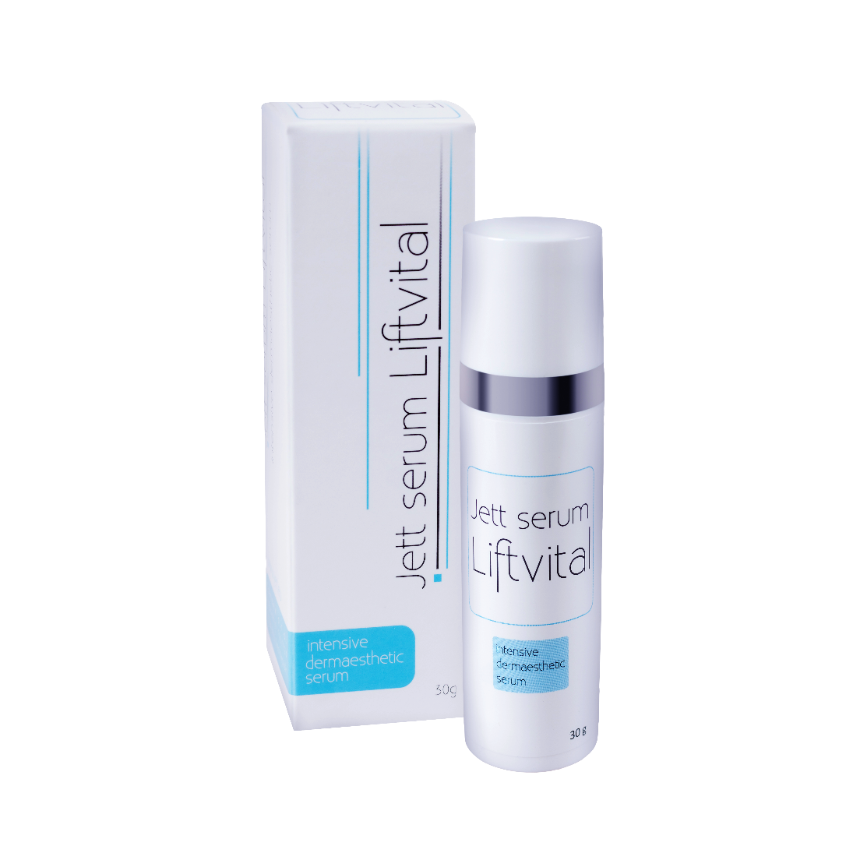
Use of JETT Plasma Lift Medical in DERMATOLOGY
str. 02/03
JETT Serum Liftvital (30ml or 400ml)
After active healing period
Cooling effect
Lifting effect
Better and faster regeneration
Neocollagenesis boost
Beauty procedure
Perfect to use with silver applicators
Lifting effect
Permanent daily use
Lifting effect
Extension of blepharoplasty effect & other anti-aging treatments

Slide 23
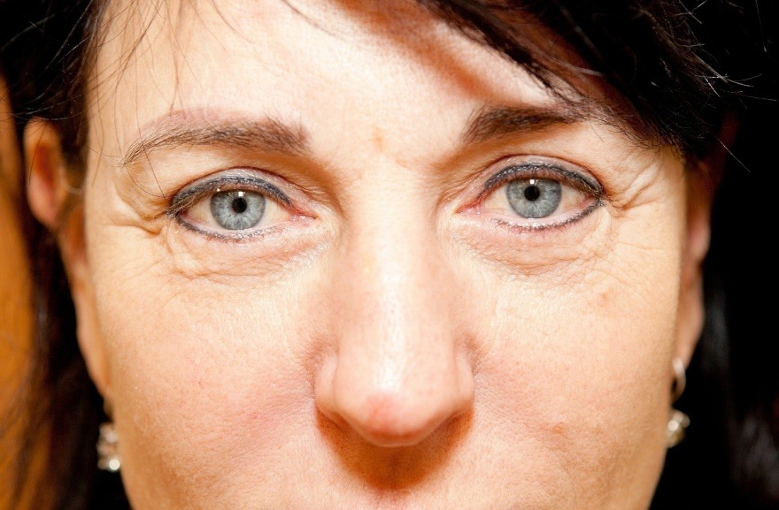
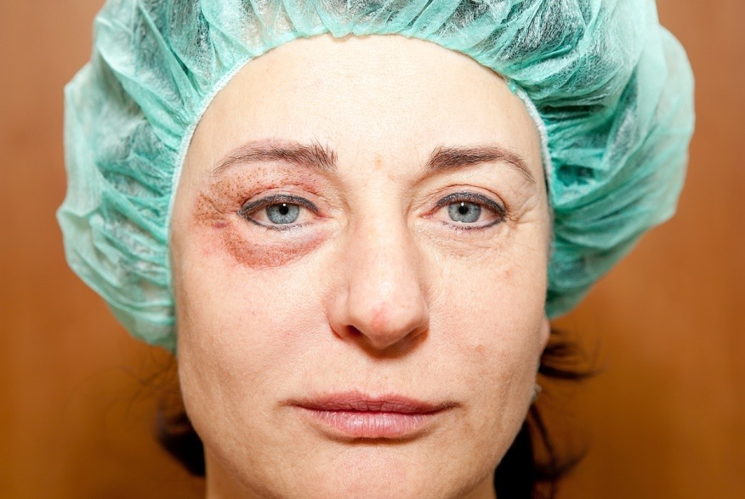
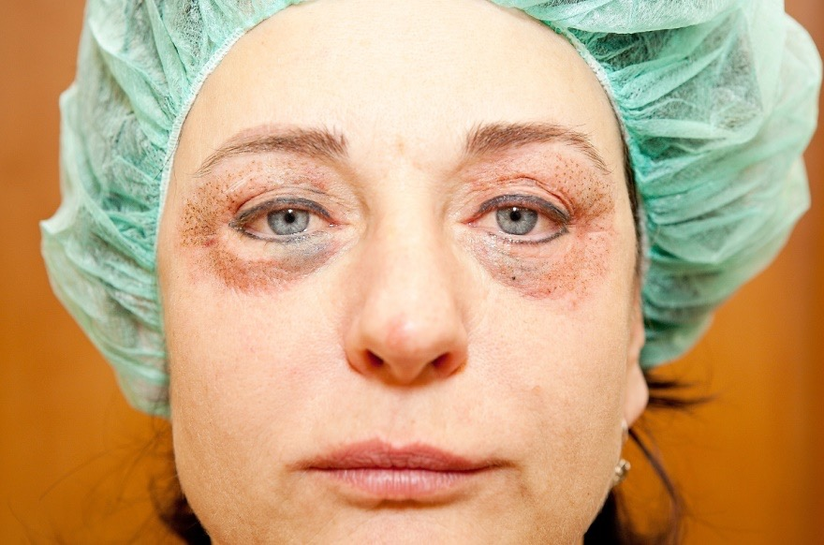
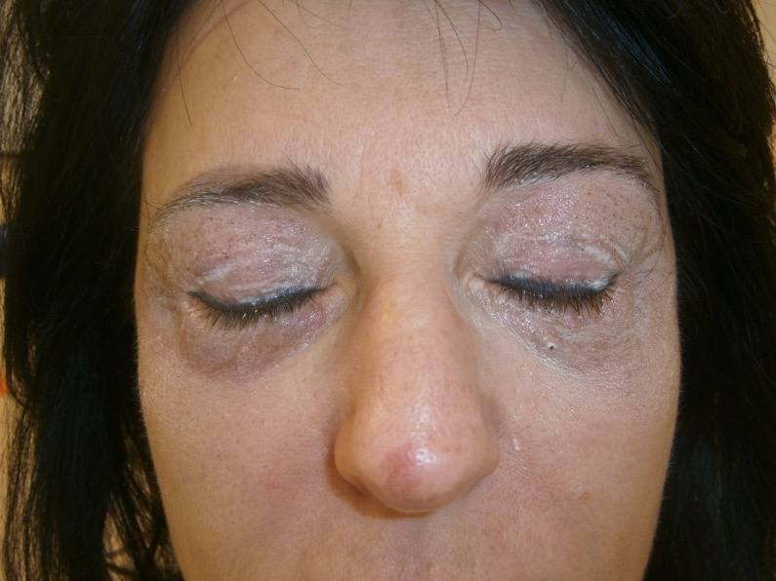
Use of JETT Plasma Lift Medical in DERMATOLOGY
str. 02/03
After the treatment

Slide 24
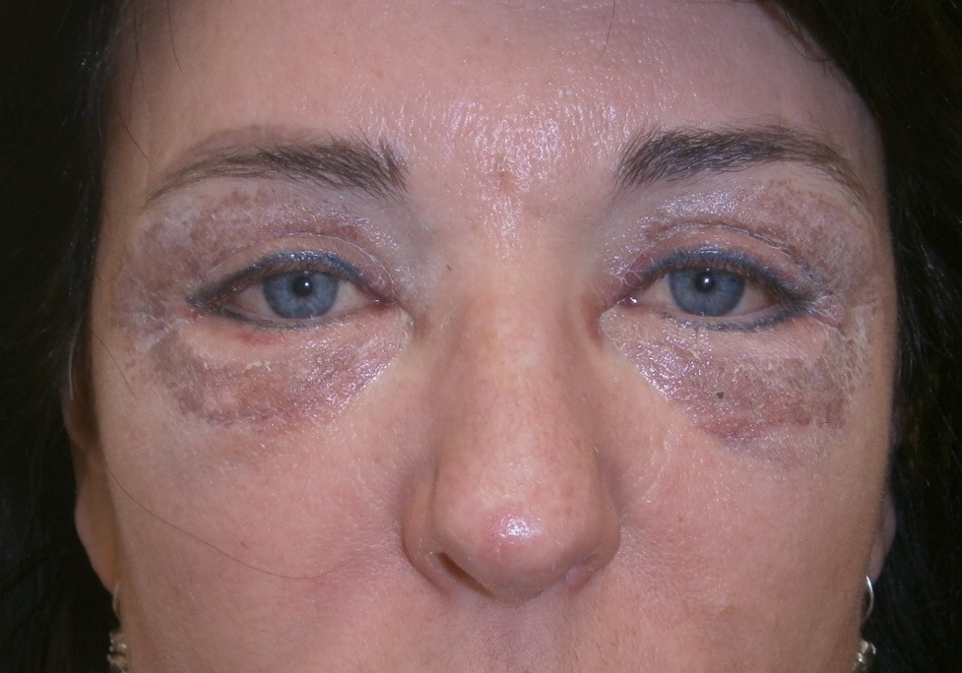
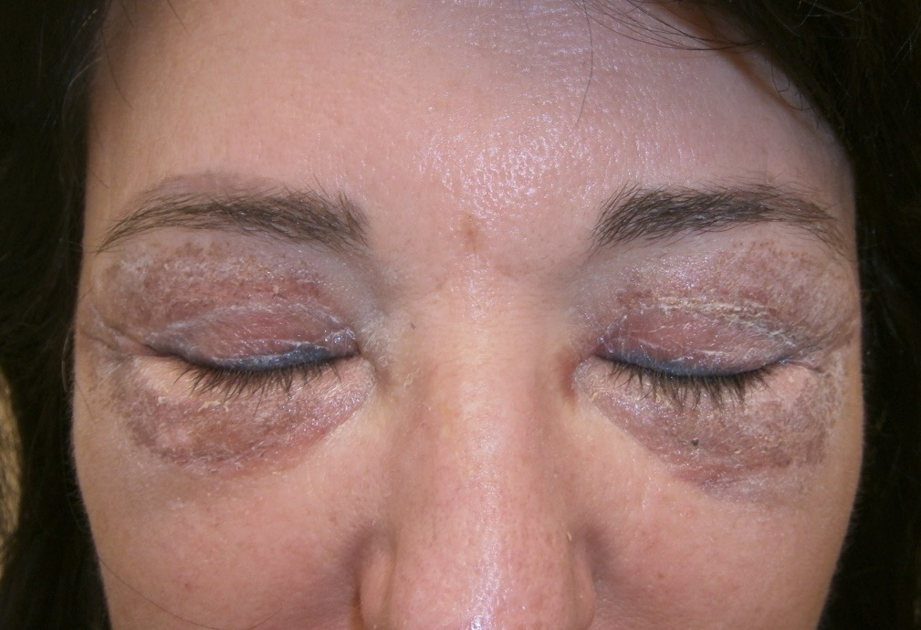
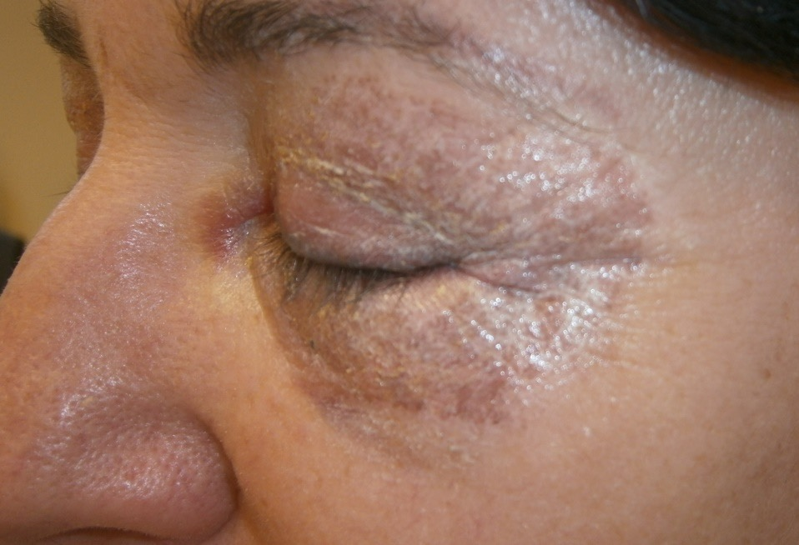
Use of JETT Plasma Lift Medical in DERMATOLOGY
str. 02/03
Pictures 4 days after

Slide 25
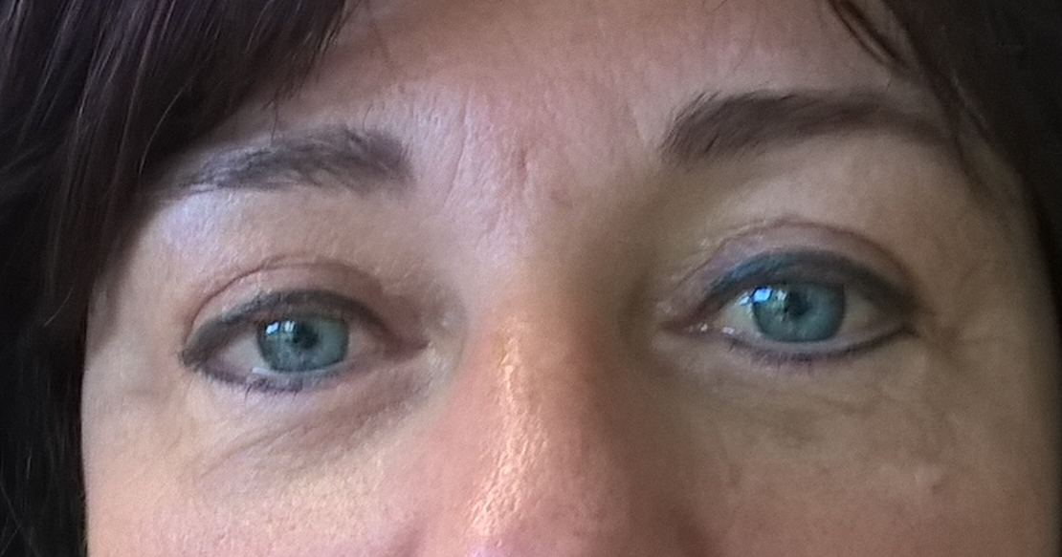
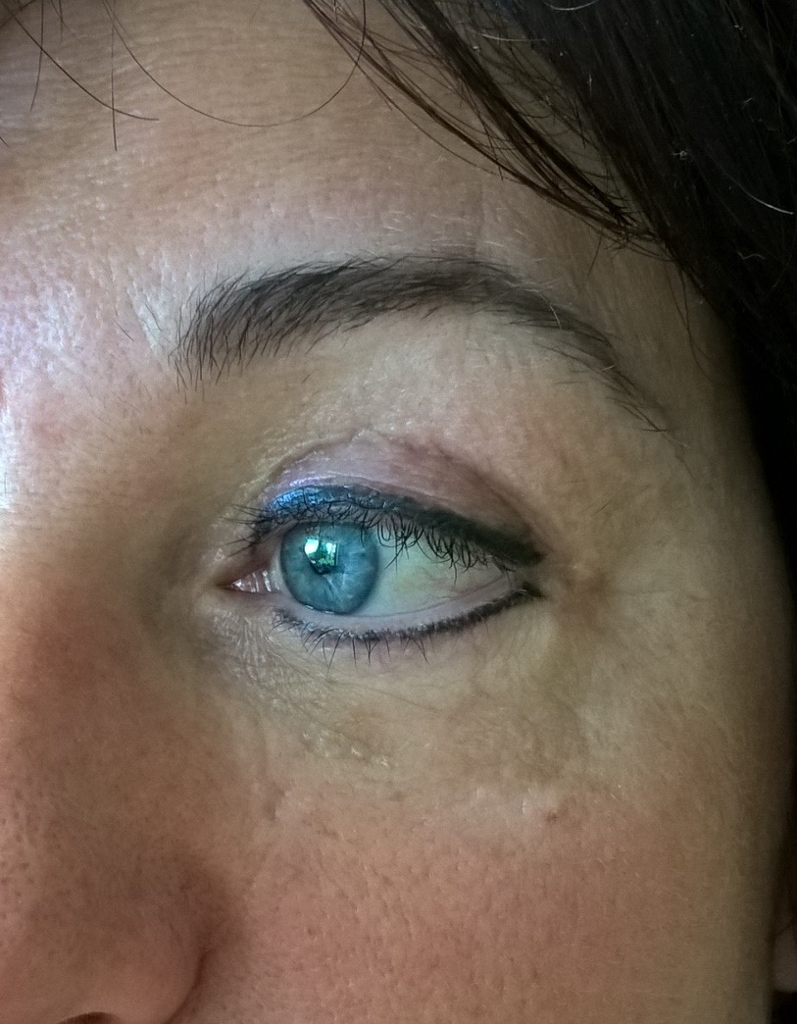
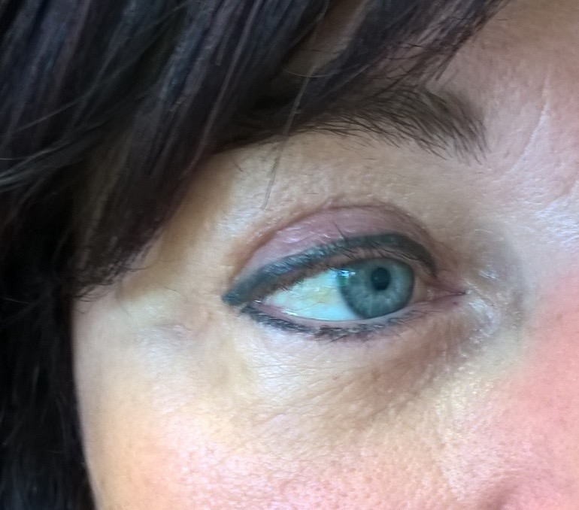
Use of JETT Plasma Lift Medical in DERMATOLOGY
str. 02/03
Pictures 3 months after

Slide 26
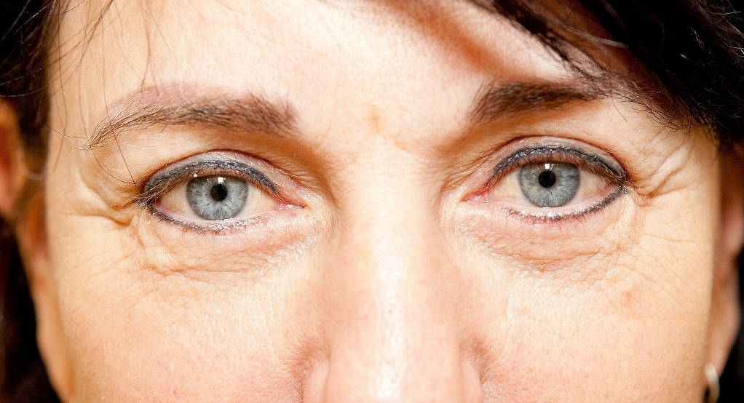
Use of JETT Plasma Lift Medical in DERMATOLOGY
str. 02/03
Before/After

Slide 27
Use of JETT Plasma Lift Medical in DERMATOLOGY
str. 02/03
Conclusion
excellent results
absolutely safe (ophthalmologist examination
after treatment, eyes without any problems, any damage)
possibility treatment of delicate area of the eyes
patient‘s satisfaction

Slide 28
