Slide 1
Blepharitis
Meibomian Glands Dysfunction

Slide 2
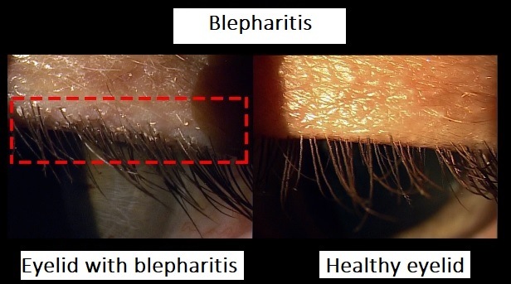
Blepharitis
Meibomian Glands Dysfunction (MGD)
Eyelid with blepharitis
Healthy eyelid

Slide 3
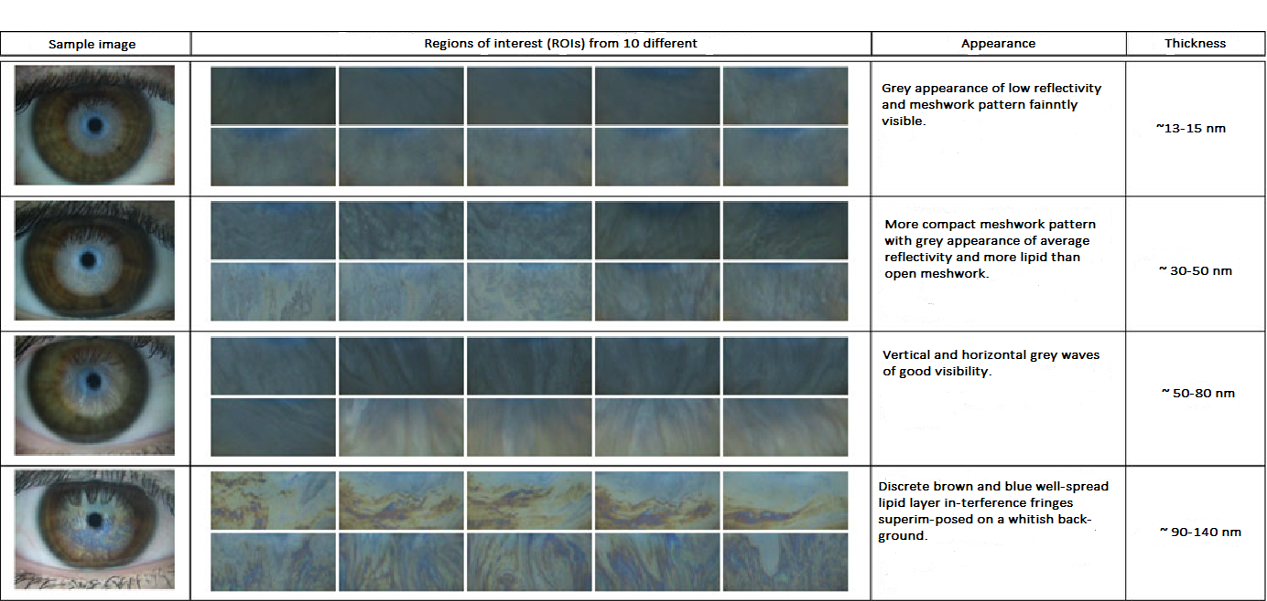
Blepharitis
Scale of lipid layer

Slide 4
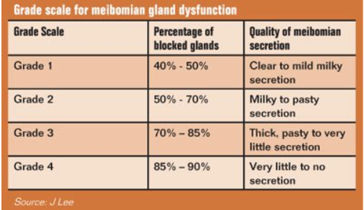
Blepharitis
Scale for secretion

Slide 5
Blepharitis
Case Report 01
Men, age 73 years
Anamnesis:
Blepharitis, Erysipel, Hypertension, Ectropium
Allergy:
Mesocain, Novalgin, Sauerkraut
Treatment:
1st control after 7 days
2nd control after 14 days
3rd control after 1 month after treatment
Objective opinion:
The condition is much better
Doesn‘t close either eye, the right a little worse, but overall improved
Both the BUT and the lipid layer improved
Subjective opinion:
Overall improvement
Doesn't close either eye
Improvement of BUT and lipid layer
Overall satisfaction

Slide 6
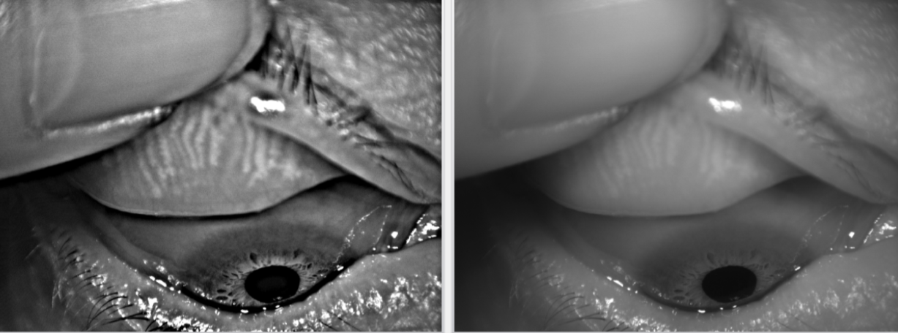
Blepharitis
Case Report 01 (OD) – Meibomian Glands – upper eyelid

Slide 7
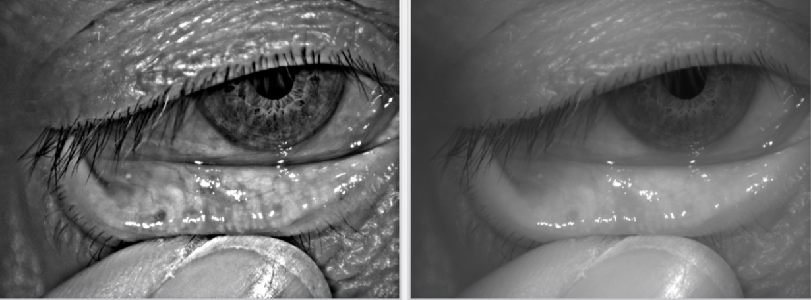
Blepharitis
Case Report 01 (OD) – Meibomian Glands – lower eyelid

Slide 8
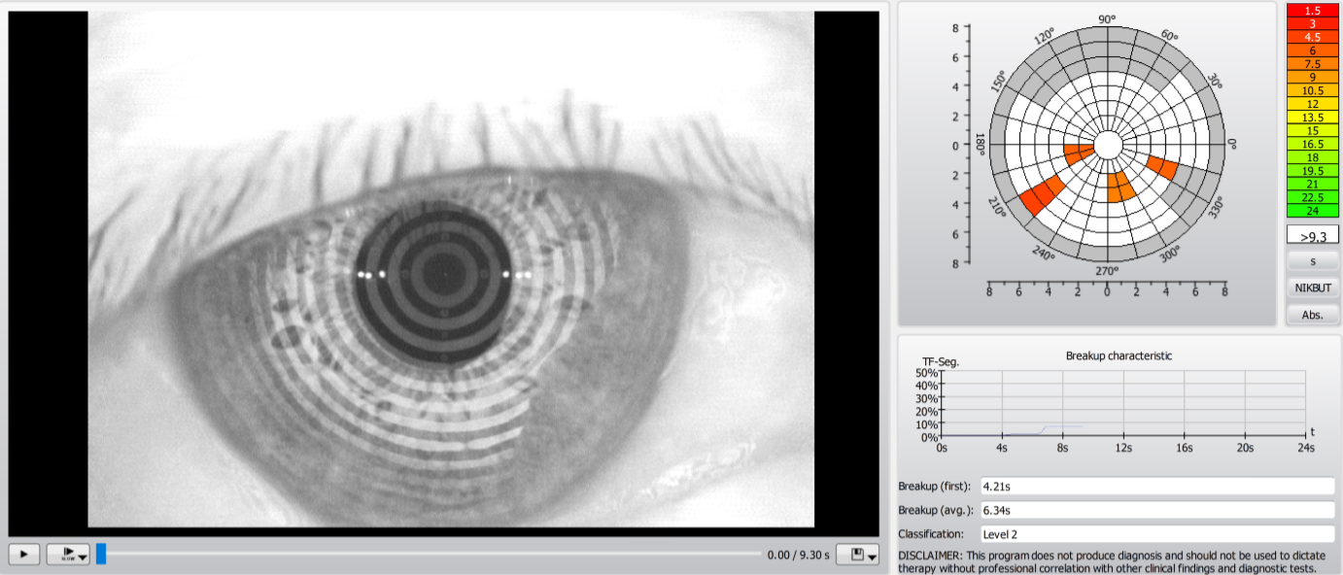
Blepharitis
Case Report 01 (OS) – Keratograph – BUT- Before

Slide 9
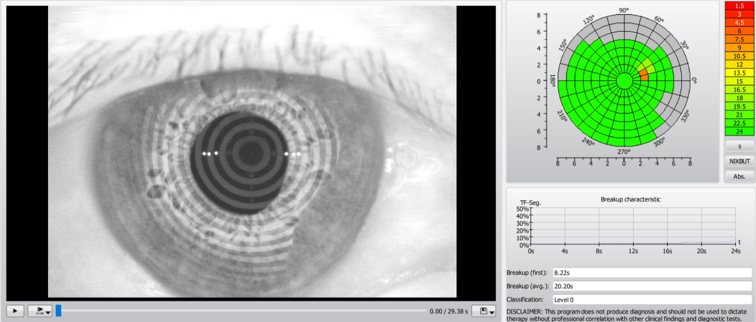
Blepharitis
Case Report 01 (OS) – Keratograph – After

Slide 10
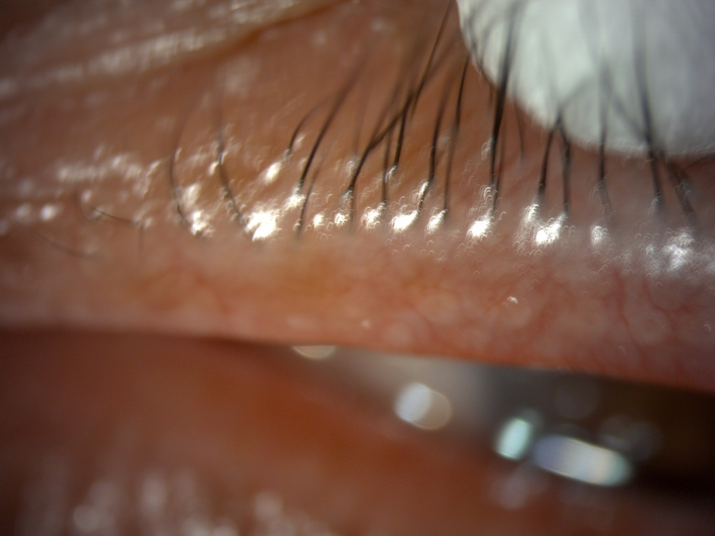
Blepharitis
Case Report 01 (OS) – Meibomian secretion before

Slide 11
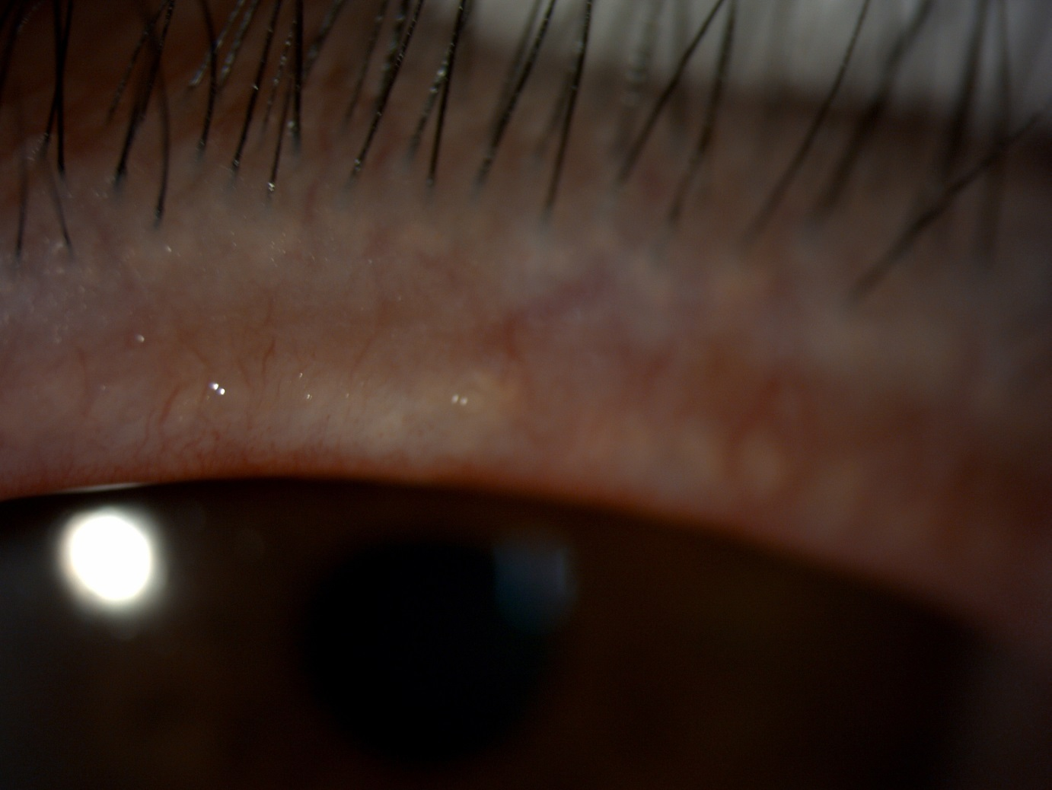
Blepharitis
Case Report 01 (OS) – Meibomian secretion after 7 days

Slide 12
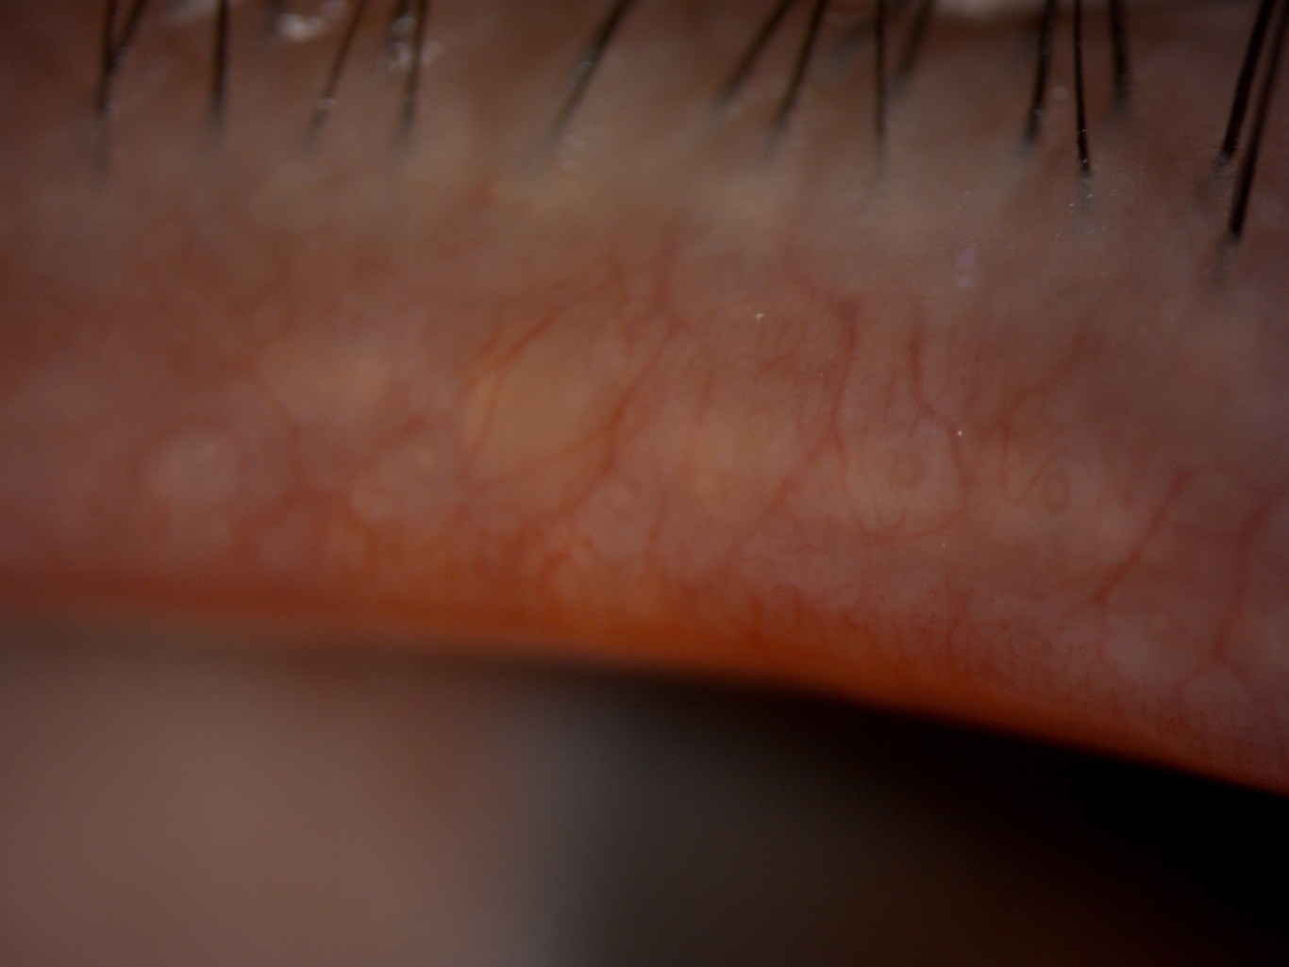
Blepharitis
Case Report 01 (OS) – Meibomian secretion after 1 month

Slide 13
Blepharitis
Case Report 01 (OS) – Keratograph – Evaluation of treatment
 | PRE-EXAMINATION |  |  | 7 DAYS AFTER |  |  | 14 DAYS AFTER |  |  | MONTH AFTER
Teardrop height in 3 positions (tempor, middle, nasal)
R | 0,44 | 0,42 | 0,41 | 0,32 | 0,31 | 0,4 | 0,29 | 0,32 | 0,31 | 0,35 | 0,38 | 0,34
L | 0,49 | 0,55 | 0,43 | 0,25 | 0,34 | 0,26 | 0,4 | 0,49 | 0,36 | 0,31 | 0,31 | 0,41
BUT- tear film decay, total average
R | 12,55 |  |  | 17,96 |  |  | 14,79 |  |  | 18,11
L | 13,38 |  |  | 10,33 |  |  | 16,55 |  |  | 15,31
BUT - tear film decay, average
R | 5,71 |  |  | 7,98 |  |  | 6,73 |  |  | 8,94
L | 5,27 |  |  | 2,84 |  |  | 8,76 |  |  | 8,41
Lipid layer - thickness (the higher the better)
R | 13-15 |  |  | 30-50 |  |  | 30-50 |  |  | 50-80
L | 13-15 |  |  | 30-50 |  |  | 30-50 |  |  | 30-50
Redness of eyes - bulbal (temporal, nasal), limbal (temporal, nasal)
R | 2,3 2,0 |  | 1,4 1,2 | 1,3 2,1 |  | 0,8 1,0 | 1,3 2,9 |  | 0,8 1,6 | 1,3 2,5 |  | 0,8 1,3
L | 1,8 1,8 |  | 1,0 0,8 | 1,9 1,3 |  | 1,0 0,6 | 2,7 1,7 |  | 2,2 0,8 | 2,3 1,2 |  | 1,1 0,7
Meimbom. Glands - degree (0. healthy - 4. significant decrease)
R UPPER | 2 |  |  | 2 |  |  | 2 |  |  | 2
L UPPER | 3 |  |  | 3 |  |  | 3 |  |  | 3
R LOWER | 3 |  |  | 3 |  |  | 3 |  |  | 3
L LOWER | 3 |  |  | 3 |  |  | 3 |  |  | 3

Slide 14
Blepharitis
Case Report 01 (OS) – Keratograph – Evaluation of treatment
SLIT LAMP
 | PRE-EXAMINATION | 7 DAYS AFTER | 14 DAYS AFTER | MONTH AFTER
CONTROL OF EYELID AND SURROUNDING
L | eyelids calm, fine | all right | all right | all right
R
CLOSING THE EYELIDS
R | does not close | does not close | does not close | does not close
L | does not close | does not close | does not close | does not close
CONTROL OF EYELASHES - SEARCH, DISCOLORATION, ENTROPION, ECTROPION
R | eyelashes fine, without problem | fine | fine | fine
L
PRESENCE OF DEMODEX - INTERVENTION SIZE
R | no | no | no | no
L
EXPRESIBILITY OF GLANDS - QUANTITY AND QUALITY
R | 2 upper, 4 lower | upper eyelid 1, lower 4 | upper eyelid 1, lower 4 | upper eyelid 1 but milky, lower 4
L

Slide 15
Blepharitis
Case Report 02 (OD)
Man, age 76 years
Anamnesis:
Sicca syndrome, Hypertension, Hypercholesterolemia, Artefakia, age-related macular degeneration
Allergy:
Metals
Treatment:
Had had the treatment twice before it was controlled – satisfied
They were treated only upper eyelids
1st control after 7 days
2nd control after 14 days
3rd control after 1 month after treatment
Objective opinion:
BUT objectively slightly increased, the rest remained the same
Secretion still the same yellow, still clogged glands
Subjective opinion:
Does not perceive the condition as an improvement

Slide 16
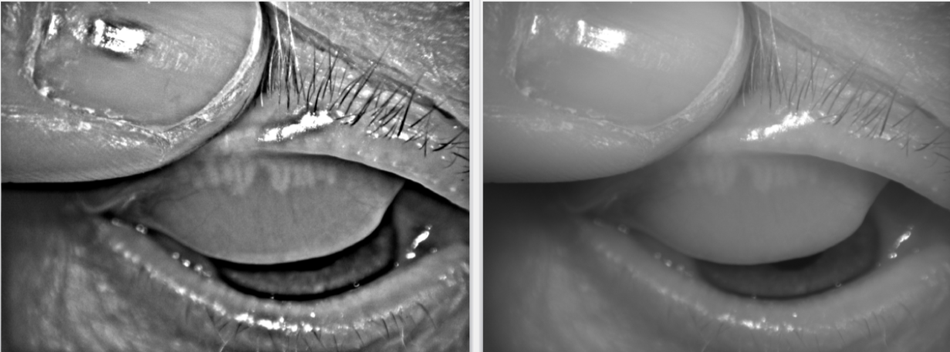
Blepharitis
Case Report 01 (OD) – Meibomian Glands – upper eyelid

Slide 17
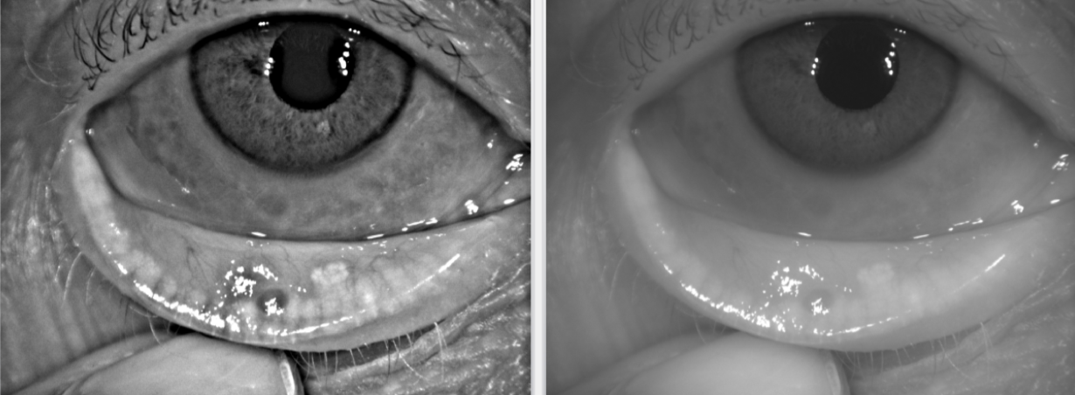
Blepharitis
Case Report 01 (OD) – Meibomian Glands – lower eyelid

Slide 18
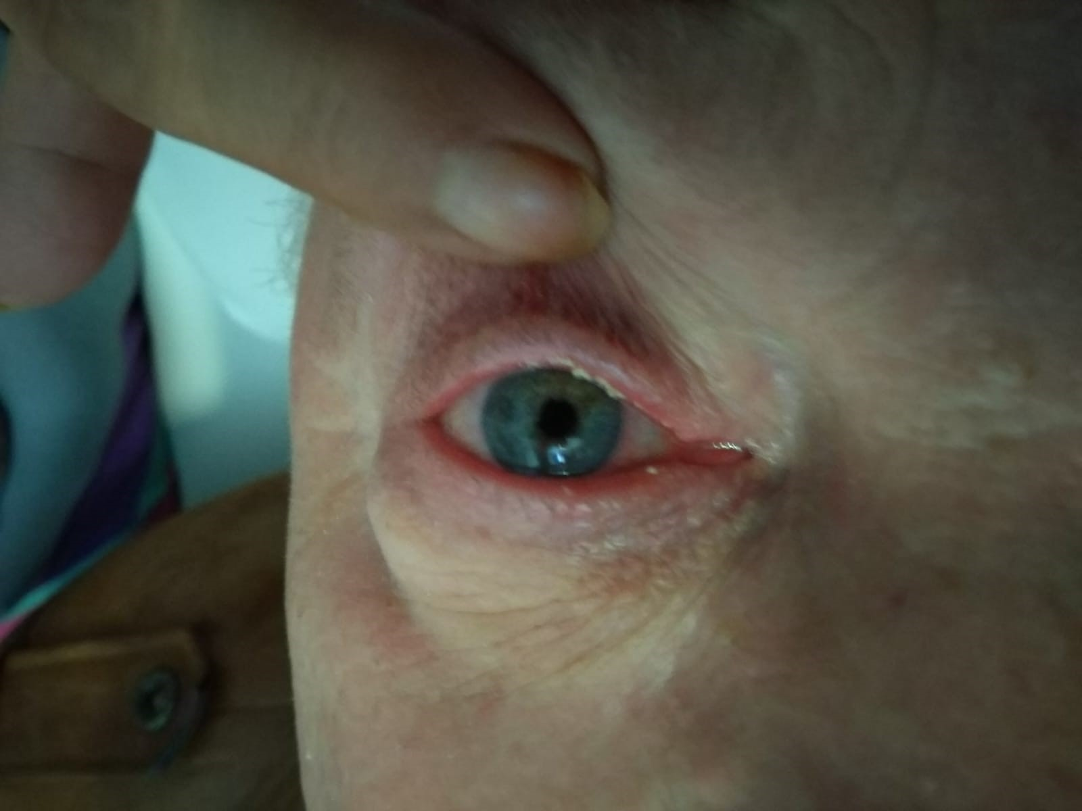
Blepharitis
Case Report 02 (OD) – Before application

Slide 19
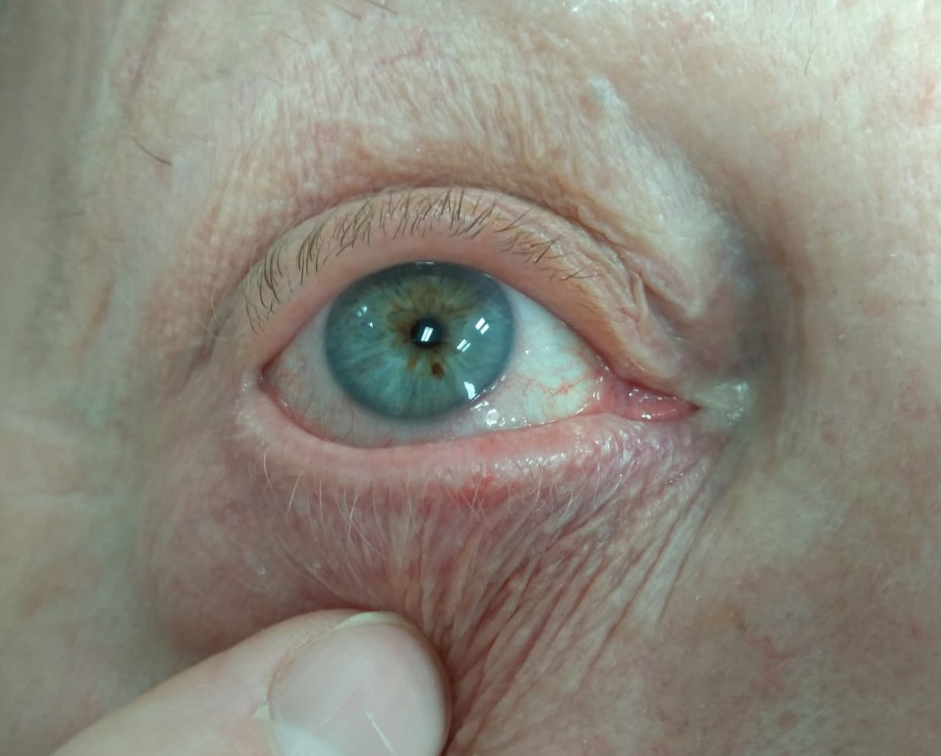
Blepharitis
Case Report 02 (OD) – After 2nd applications, before 3rd application

Slide 20
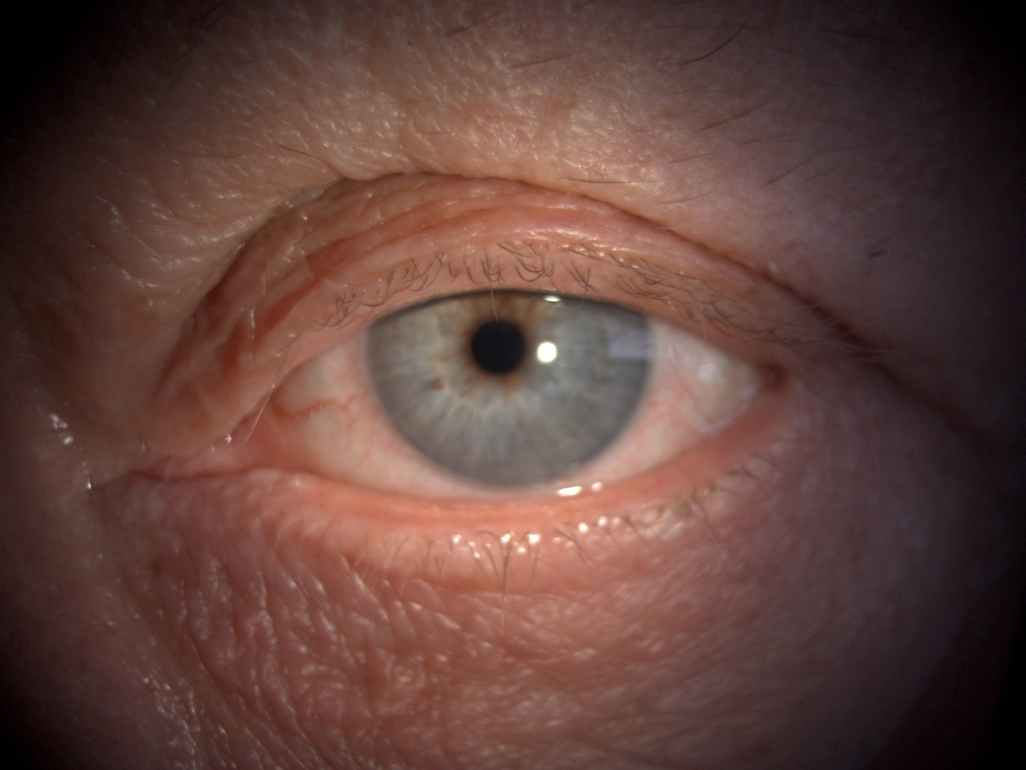
Blepharitis
Case Report 02 (OD) – 1 month after 3rd application

Slide 21
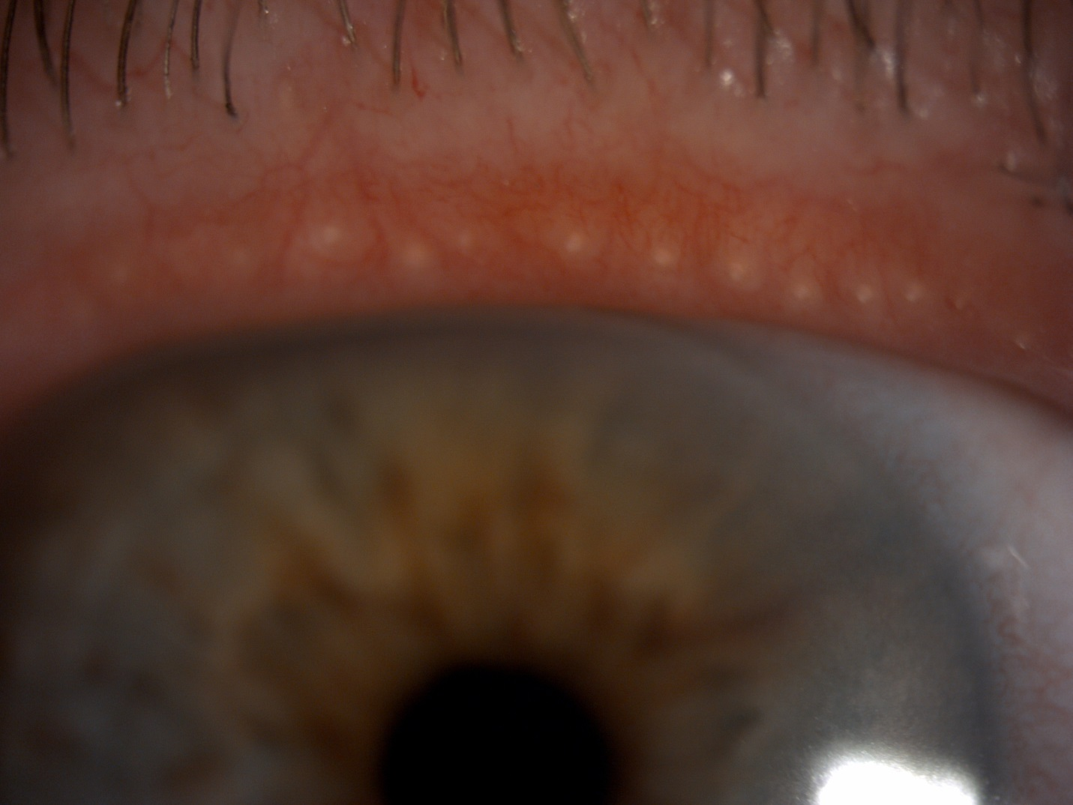
Blepharitis
Case Report 02 (OD) – Meibomian secretion before the 3rd application

Slide 22
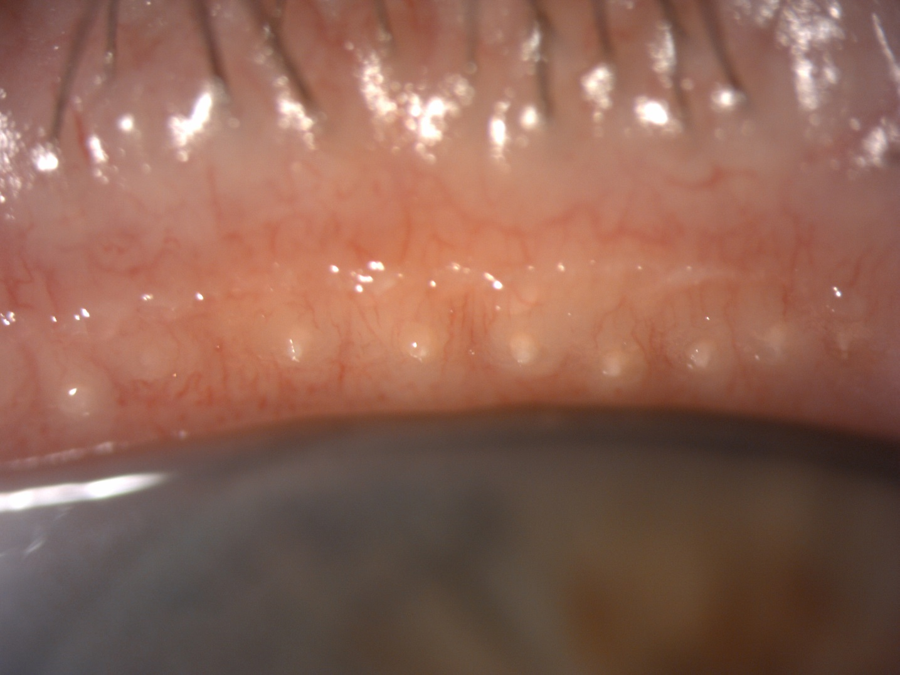
Blepharitis
Case Report 02 (OD) – Meibomian secretion 1 month after 3rd application

Slide 23
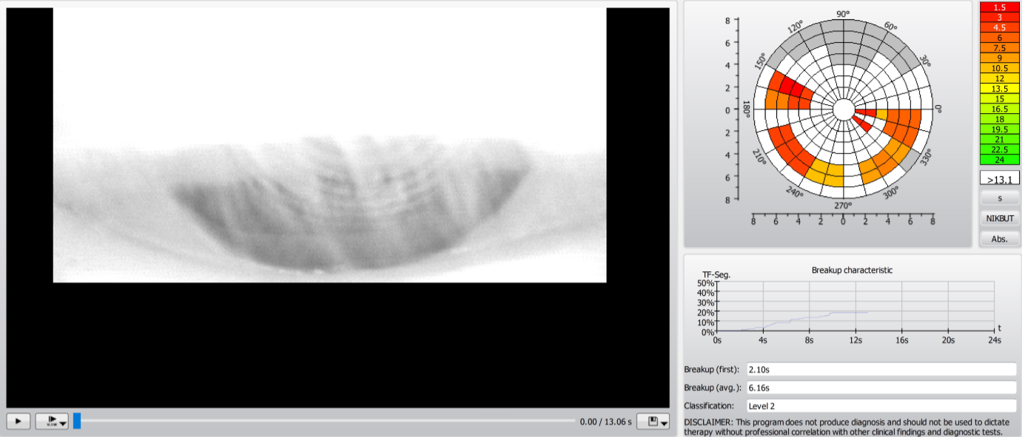
Blepharitis
Case Report 02 (OD) – Keratograph BUT – Before

Slide 24
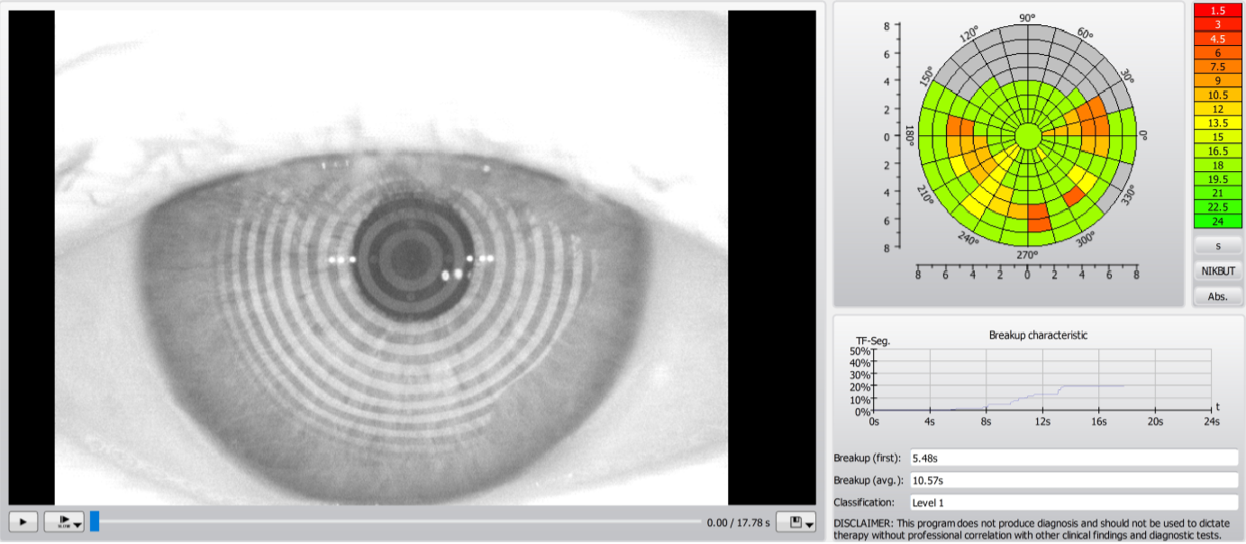
Blepharitis
Case Report 02 (OD) – Keratograph BUT – After 1 month

Slide 25
Blepharitis
Case Report 02 (OD) – Keratograph – Evaluation of treatment
 | PRE-EXAMINATION |  |  | 7 DAYS AFTER |  |  | 14 DAYS AFTER |  |  | MONTH AFTER
Teardrop height in 3 positions (tempor, middle, nasal)
L | 47 | 36 | 36 | 38 | 40 | 47 | 66 | 55 | 47 | 0,35 | 0,31 | 0,29
R | 33 | 41 | 39 | 28 | 30 | 44 | 31 | 36 | 50 | 0,24 | 0,31 | 0,51
BUT- tear film decay, total average
R | 8,5 |  |  | 9,82 |  |  | 9,03 |  |  | 8,69
L | 5,8 |  |  | 7,83 |  |  | 7,8 |  |  | 4,72
BUT - tear film decay, average
R | 2,55 |  |  | 4,43 |  |  | 4,95 |  |  | 4,37
L | 3,42 |  |  | 3,95 |  |  | 4,73 |  |  | 4,715
Lipid layer - thickness (the higher the better)
R | 13-15 |  |  | 13-15 |  |  | 13-15 |  |  | 13-15
L | 13-15 |  |  | 13-15 |  |  | 13-15 |  |  | 13-15
Redness of eyes - bulbal (temporal, nasal), limbal (temporal, nasal)
R | 1,3 1,8 |  | 1,0 1,8 | 1,4 1,1 |  | 0,7 1,1 | 0,9 1,4 |  | 0,7 1,0 | 1,8 2,6 |  | 1,8 2,8
L | 1,8 2,4 |  | 1,3 1,9 | 1,6 1,6 |  | 1,2 0,9 | 1,3 1,4 |  | 1,0 0,8 | 1,6 2,1 |  | 1,4 1,3
Meimbom. Glands - degree (0. healthy - 4. significant decrease)
R UPPER | 3 |  |  | 3 |  |  | 3 |  |  | 3
L UPPER | 3 |  |  | 3 |  |  | 3 |  |  | 3
R LOWER | 3 |  |  | 3 |  |  | 3 |  |  | 3
L LOWER | 3 |  |  | 3 |  |  | 3 |  |  | 3

Slide 26
Blepharitis
Case Report 02 (OD) – Keratograph – Evaluation of treatment
SLIT LAMP
 | PRE-EXAMINATION | 7 DAYS AFTER | 14 DAYS AFTER | MONTH AFTER
CONTROL OF EYELIDS AND SURROUNDING
L | Eyelids calm | Eyelids calm | Eyelids calm | Eyelids calm
R
CLOSING OF EYELIDS
R | yes | yes | yes | yes
L | yes | yes | yes | yes
CONTROL OF EYELIDS - SEARCH, DISCOLORATION, ENTROPION, ECTROPION
R | no | no | no | no
L | no | no | no | no
PRESENCE OF DEMODEX - INTERVENTION SIZE
R | no | no | no | no
L | no | no | no | no
EXPRESIBILITY OF GLANDS - QUANTITY AND QUALITY
R | 3 upper, 2 lower | 3 upper, 2 lower | 3 upper, 2 lower | 3 upper and lower
L

Slide 27
Blepharitis
Case Report 03 (OD)
Man, age 34 years
Anamnesis:
Meibomitis, Rosacea (may affect the success of treatment), Demodex
Allergy: none
Treatment:
1st control after 7 days
2nd control after 14 days
3rd control after 1 month after treatment
Objective opinion:
Right eye better than left
BUT still better than before treatment
Expression still nice
Subjective opinion:
The gent perceives everything in order, subjectively getting better than before application
Still a little redness, but less than before

Slide 28
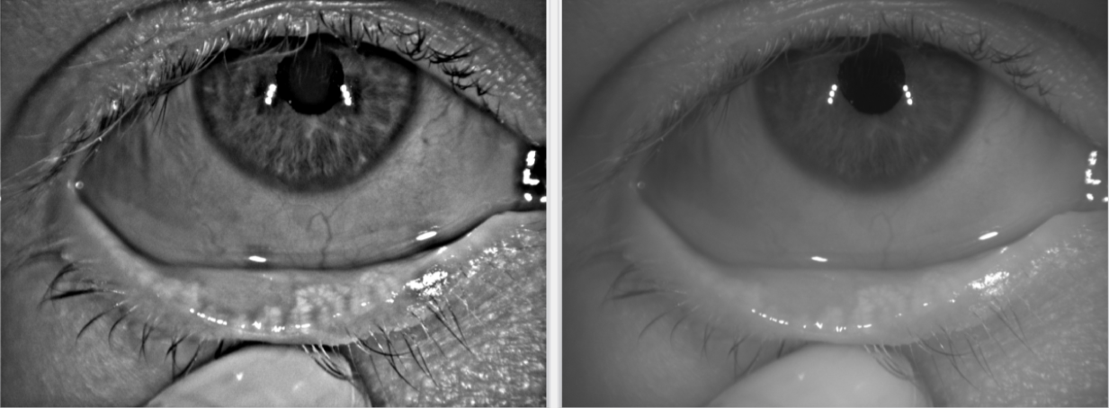
Blepharitis
Case Report 03 (OD) – Meibomian Glands – lower eyelid

Slide 29
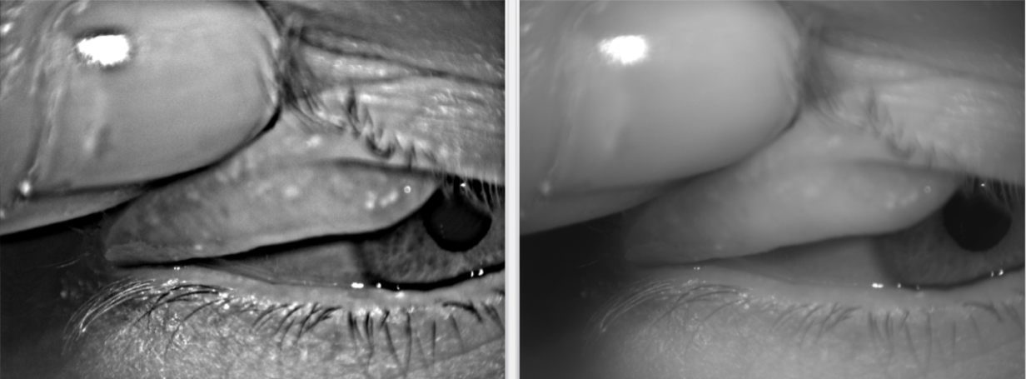
Blepharitis
Case Report 03 (OD) – Meibomian Glands – upper eyelid

Slide 30
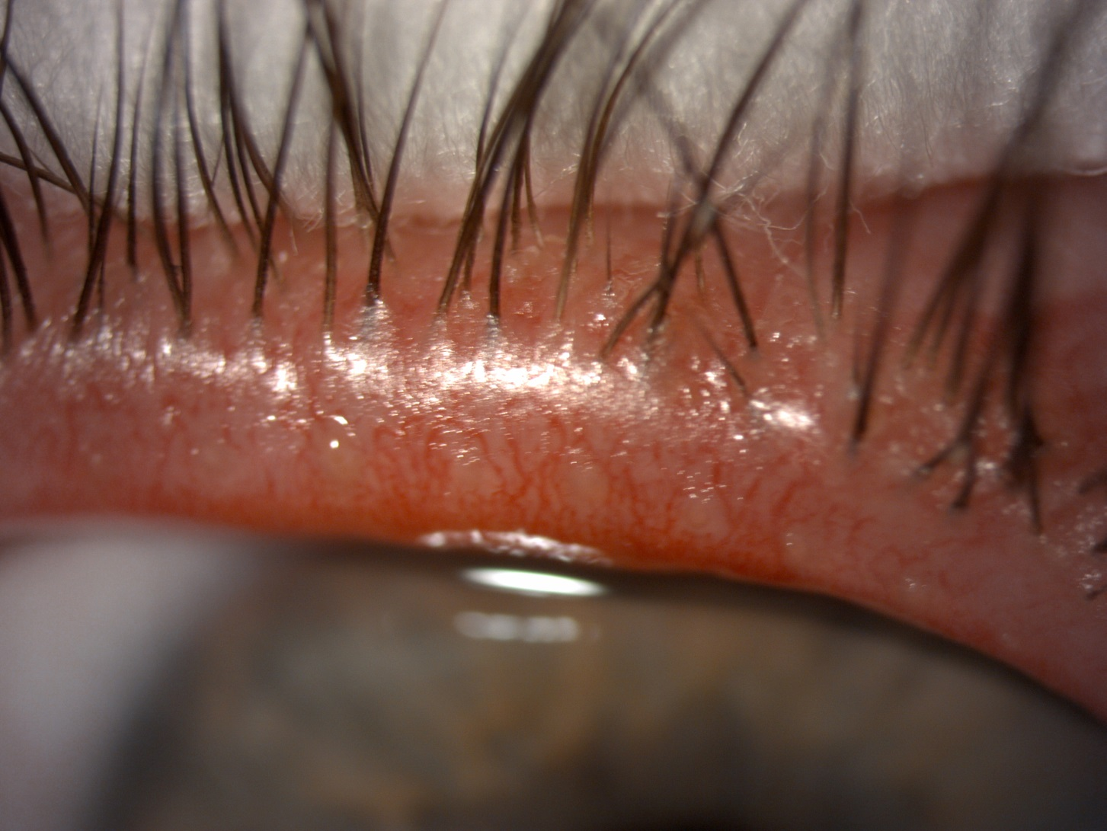
Blepharitis
Case Report 03 (OD) - Meibomian secretion before

Slide 31
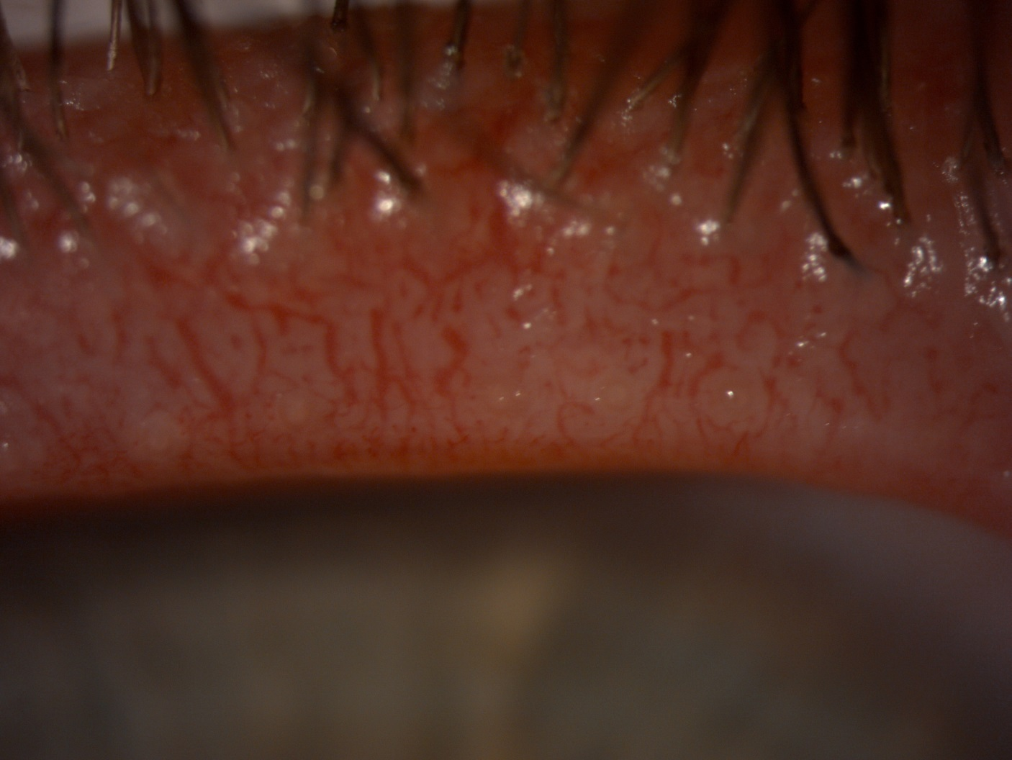
Blepharitis
Case Report 03 (OD) – Meibomian secretion after 1 month

Slide 32
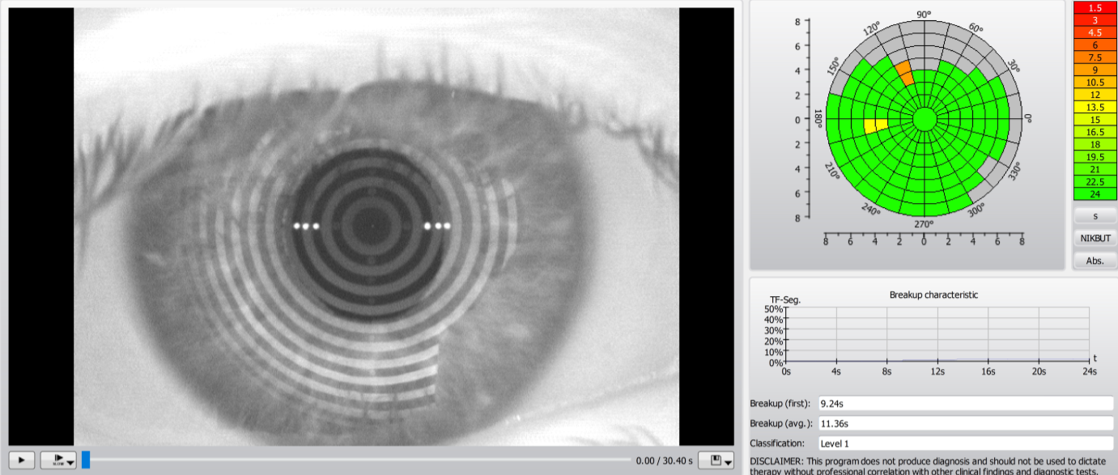
Blepharitis
Case Report 03 (OD) – Keratograph BUT – Before

Slide 33
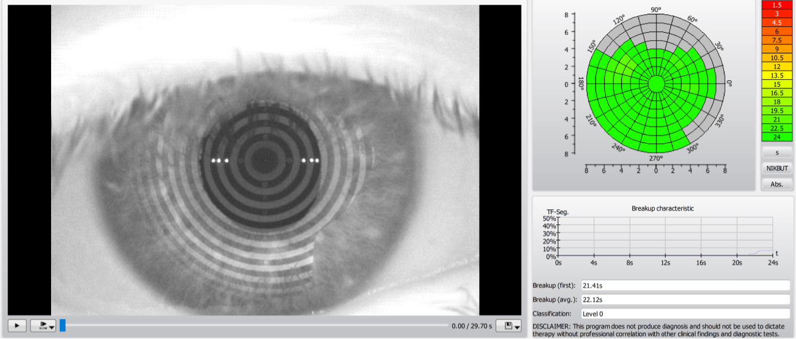
Blepharitis
Case Report 03 (OD) – Keratograph BUT – After 1 month

Slide 34
Blepharitis
Case Report 03 (OD) – Keratograph – Evaluation of treatment
 | PRE-EXAMINATION |  |  | 7 DAYS AFTER |  |  | 14 DAYS AFTER |  |  | MONTH AFTER
Teardrop height in 3 positions (tempor, middle, nasal)
L | 0,43 | 0,52 | 0,46 | 0,32 | 0,42 | 0,41 | 0,38 | 0,23 | 0,29 | 0,3 | 0,36 | 0,34
R | 0,38 | 0,43 | 0,44 | 0,29 | 0,38 | 0,38 | 0,25 | 0,23 | 0,25 | 0,29 | 0,34 | 0,29
BUT- tear film decay total average
R | 19,78 |  |  | 20,78 |  |  | 22,03 |  |  | 20,78
L | 19,77 |  |  | 19,03 |  |  | 16,03 |  |  | 19,03
BUT -tear film decay, average
R | 18,41 |  |  | 20,11 |  |  | 20,24 |  |  | 20,78
L | 8,24 |  |  | 11,85 |  |  | 10,2 |  |  | 11,85
Lipid layer - thickness (the higher the better)
R | 30-50 |  |  | 50-80 |  |  | 90-140 |  |  | 30-50
L | 13-15 |  |  | 30-50 |  |  | 90-140 |  |  | 13-15
Redness of eyes - bulbal (temporal, nasal), limbal (temporal, nasal)
R | 0,5 0,5 |  | 0,4 0,3 | 0,6 1,1 |  | 0,5 0,8 | 0,5 1,4 |  | 0,4 0,8 | 0,6 1,1 |  | 0,5 0,8
L | 1,5 1,6 |  | 1,0 1,4 | 1,8 0,7 |  | 0,8 0,5 | 1,6 0,6 |  | 1,0 0,9 | 1,8 0,7 |  | 0,8 0,5
Meimbom. Glands - degree (0. healthy - 4. significant decrease)
R UPPER | 4 |  |  | 4 |  |  | 4 |  |  | 4
L UPPER | 4 |  |  | 4 |  |  | 4 |  |  | 4
R LOWER | 3 |  |  | 3 |  |  | 3 |  |  | 3
L LOWER | 3 |  |  | 3 |  |  | 3 |  |  | 3

Slide 35
Blepharitis
Case Report 03 (OD) – Keratograph – Evaluation of treatment
SLIT LAMP
 | PRE-EXAMINATION | 7 DAYS AFTER | 14 DAYS AFTER | MONTH AFTER
CONTROL OF EYELID AND SURROUNDING
L | Eyelashes glued a lot, red eyes, both eyes affected similarly |  | significant improvement, eyelashe less glued, eyes less red | eyelashes glued in a few places, eyes less red
R
CLOSING OF EYELID AND SURROUNDING
R | yes | yes | yes | yes
L | yes | yes | yes | yes
CONTROL OF EYELASHES - SEARCH, DISCOLORATION, ENTROPION, ECTROPION
R | no | no | no | no
L | no | no | no | no
PRESENCE OF DEMODEX - INTERVENTION SIZE
R | yes, lightly |  | yes, less than before | yes, less than before
L | yes, lightly |  | yes, less than before | yes, less than before
EXPRESIBILITY OF GLANDS - QUANTITY AND QUALITY
R | 2 everywhere | 1 everywhere | 1, grain was formed on the left eye | 1 everywhere, except the left upper eyelid- there 2
L

Slide 36
Blepharitis
Case Report 04 (OD)
Woman, age 80 years
Anamnesis:
Sicca syndrom, Meibomiana, Epitelopatia cornae, Keratitis punctata (the left eye could not be measured), Stroke (2006)
Allergy: none
Treatment:
1st control after 7 days
2nd control after 14 days
3rd control after 1 month after treatment
Objective opinion:
Secretion greater, nicely clear
The lipid layer is always the same
Subjective opinion:
Subjective feelings better

Slide 37
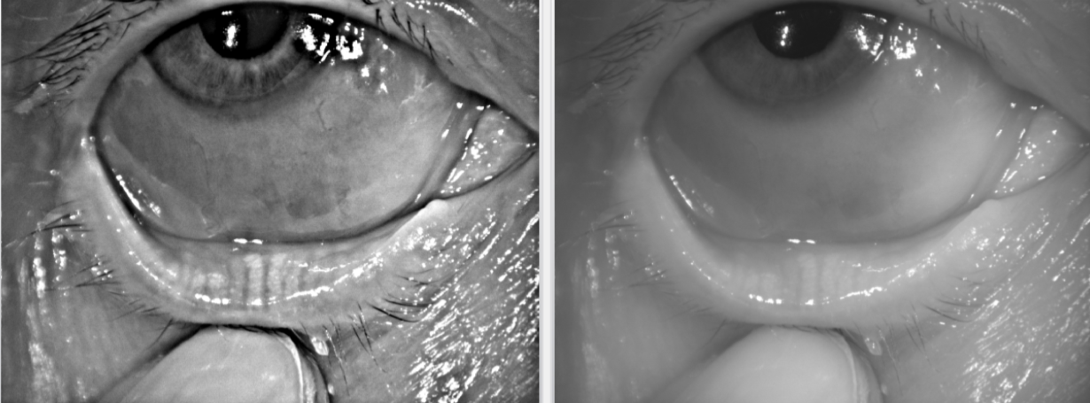
Blepharitis
Case Report 04 (OD) – Meibomian Glands – lower eyelid

Slide 38
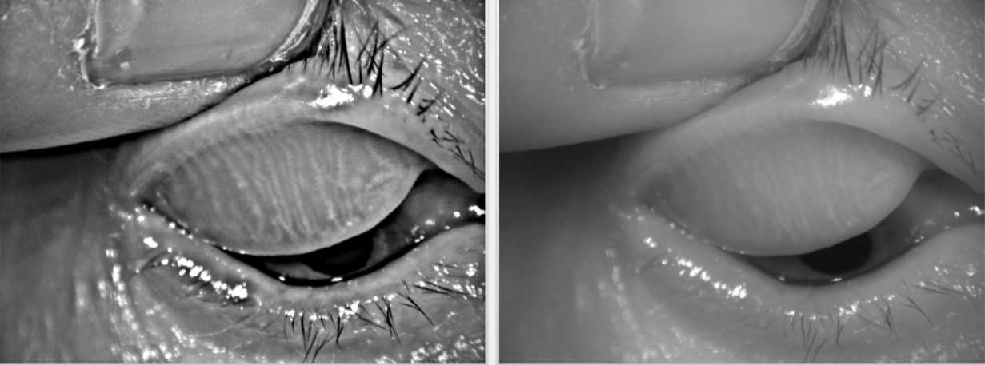
Blepharitis
Case Report 04 (OD) – Meibomian Glands – upper eyelid

Slide 39
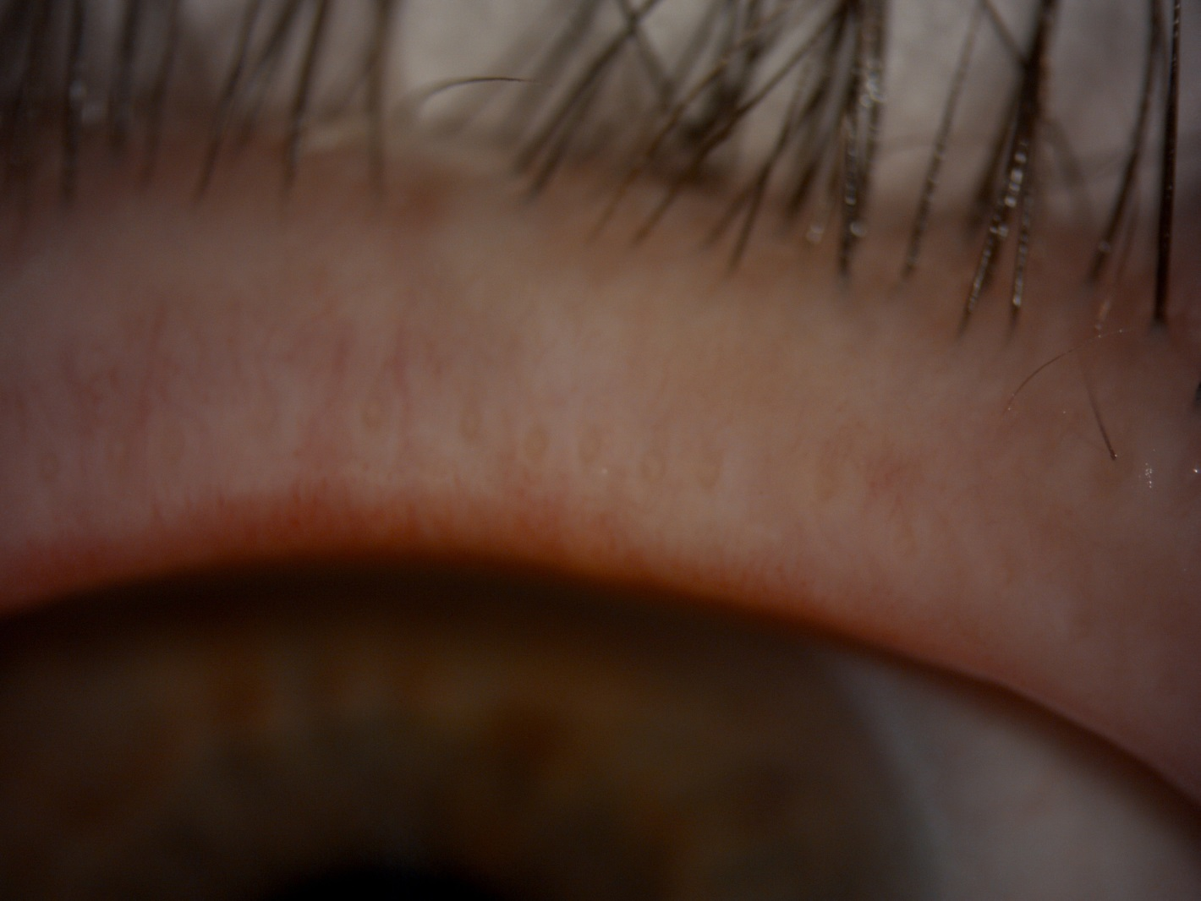
Blepharitis
Case Report 04 (OD) – Meibomian secretion before

Slide 40
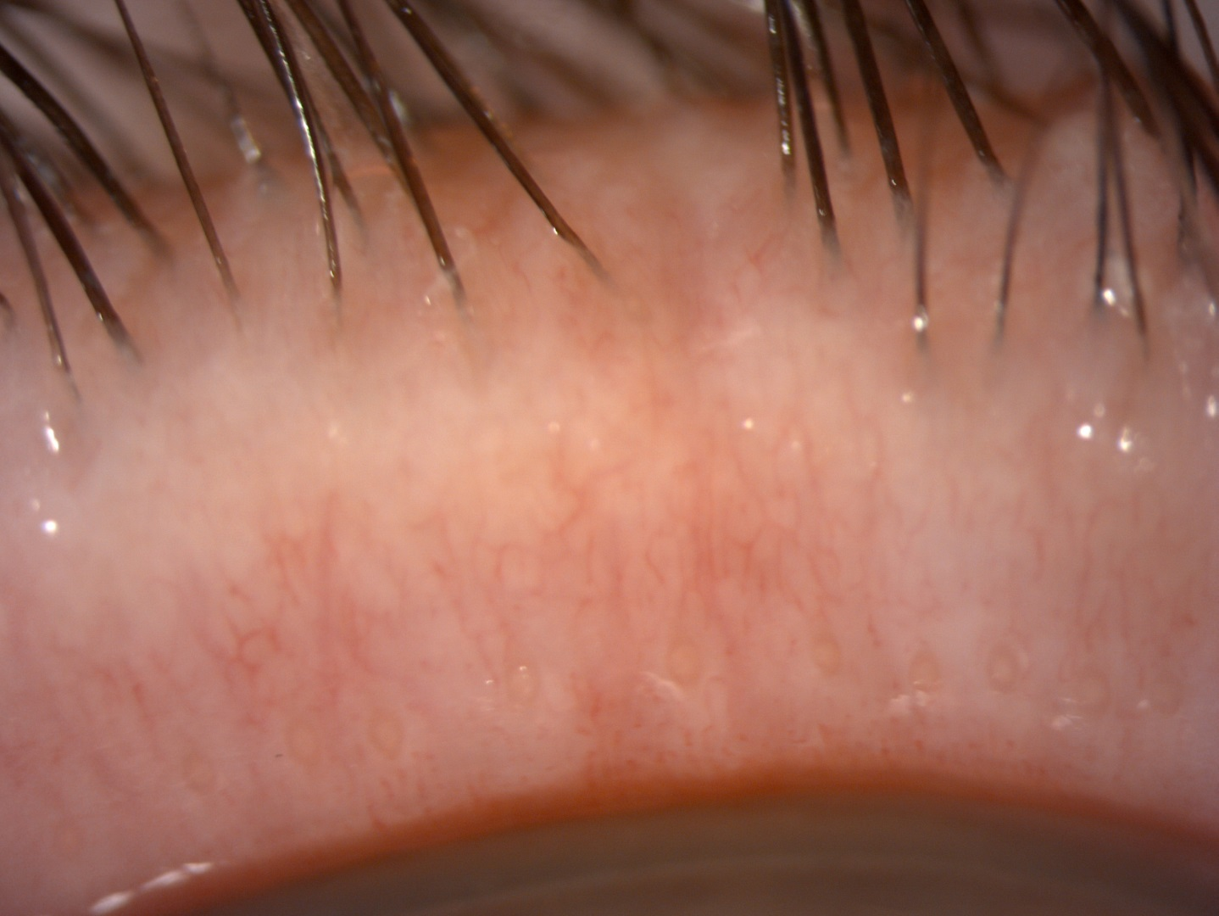
Blepharitis
Case Report 04 (OD) – Meibomian secretion after 1 month

Slide 41
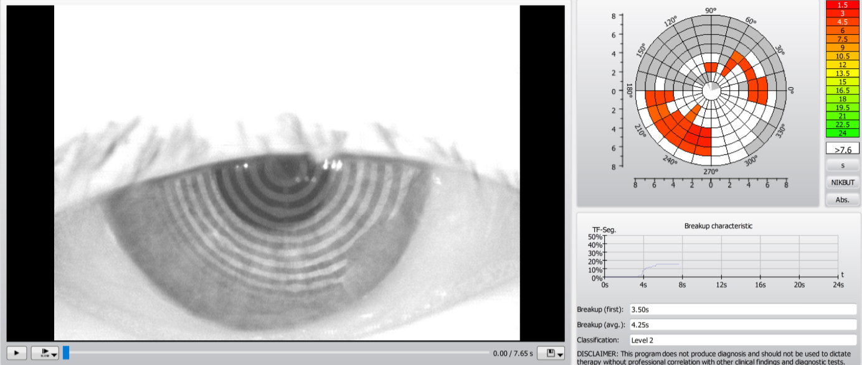
Blepharitis
Case Report 04 (OD) – Keratograph BUT – Before

Slide 42
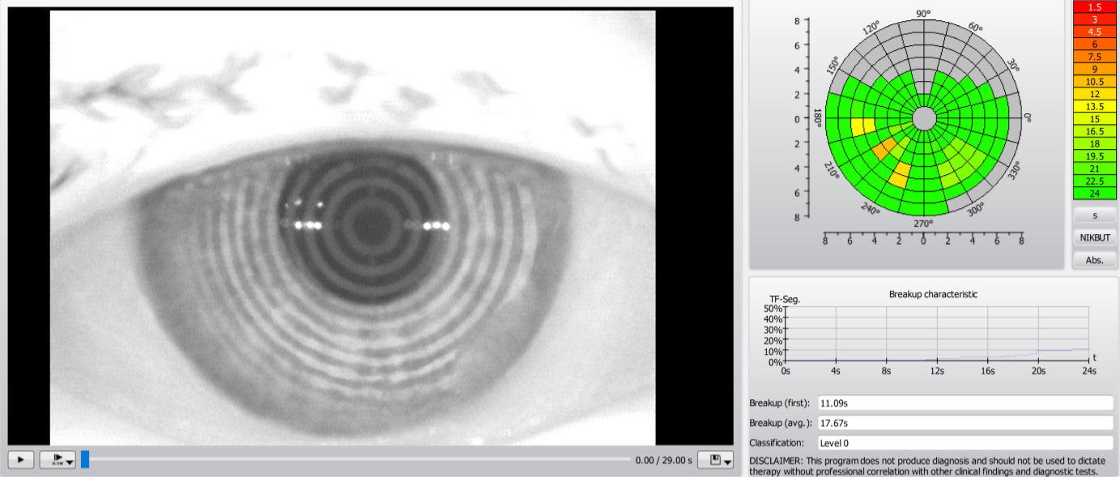
Blepharitis
Case Report 04 (OD) – Keratograph BUT – After 1 month

Slide 43
Blepharitis
Case Report 04 (OD) – Keratograph – Evaluation of treatment
 | PRE-EXAMINATION |  |  | 7 DAYS AFTER |  |  | 14 DAYS AFTER |  |  | MONTH AFTER
Teardrop height in 3 positions (tempor, middle, nasal)
L | 72 | 42 | 33 | 37 | 29 | 25 | 50 | 38 | 42 | 50 | 94 | 67
R | 46 | 53 | 54 | 40 | 55 | 49 | 52 | 56 | 49 | 51 | 35 | 45
BUT - tear film decay, total average
R | 13,46 |  |  | 12,5 |  |  | 15,17 |  |  | 16,33
L | 15,96 |  |  | cannot |  |  | cannot |  |  | 11,135
BUT - tear film decay, average
R | 4,27 |  |  | 6,41 |  |  | 7,35 |  |  | 7,37
L | 7,96 |  |  | cannot |  |  | cannot |  |  | 5,96
Lipid layer - thickness (the higher the better)
R | 13-15 |  |  | 13-15 |  |  | 13-15 |  |  | 13-15
L | 13-15 |  |  | 13-15 |  |  | 13-15 |  |  | 13-15
Redness of eyes - bulbal (temporal, nasal), limbal (temporal, nasal)
R | 1,6 1,3 |  | 1,3 1,0 | 1,7 1,6 |  | 1,4 1,1 | 1,3 1,0 |  | 1,0 0,7 | 1,4 0,9 |  | 1,0 0,7
L | 1,7 1,8 |  | 1,0 0,7 | 1,8 1,3 |  | 1,3 1,0 | 1,5 0,9 |  | 1,3 0,9 | 1,5 1,2 |  | 1,1 0,8
Meimbom. Glands - degree (0. healthy - 4. significant decrease)
R UPPER | 3 |  |  | 3 |  |  | 3 |  |  | 3
L UPPER | 2 |  |  | 2 |  |  | 2 |  |  | 2
R LOWER | 2 |  |  | 2 |  |  | 2 |  |  | 2
L LOWER | 3 |  |  | 3 |  |  | 3 |  |  | 3

Slide 44
Blepharitis
Case Report 04 (OD) – Keratograph – Evaluation of treatment
SLIT LAMP
 | PRE-EXAMINATION | 7 DAYS AFTER | 14 DAYS AFTER | MONTH AFTER
CONTROL OF EYELID AND SURROUNDING
L | eyes calm, uses eyeliner cream | eye calm, visible cream on eyelids and eyelashes | eyes calm | eyes calm, again cream on eyelashes
R
CLOSING THE EYELIDS
R | yes | yes | yes | yes
L | yes | yes | yes | yes
CONTROL OF EYELASHES - SEARCH, DISCOLORATION, ENTROPION, ECTROPION
R | no | no | no | no
L | no | no | no | no
PRESENCE OF DEMODEX - INTERVENTION SIZE
R | no | no | no | no
L | no | no | no | no
EXPRESIBILITY OF GLANDS - QUANTITY AND QUALITY
R | 1 | 1- more | 1- more than befor | 1
L

Slide 45
Blepharitis
Case Report 05 (OS)
Woman, age 74 years
Anamnesis:
Hypertension, hypercholesterolemia, thyroid disease, after neck surgery for cancer
Allergy: none
Treatment:
1st control after 7 days
2nd control after 14 days
3rd control after 1 month after treatment
Objective opinion:
Secretion better, clear and sufficient quantity
BUT left worse, right BUT better
Yet very dry eye
Subjective opinion:
Nevertheless, the patient is satisfied

Slide 46
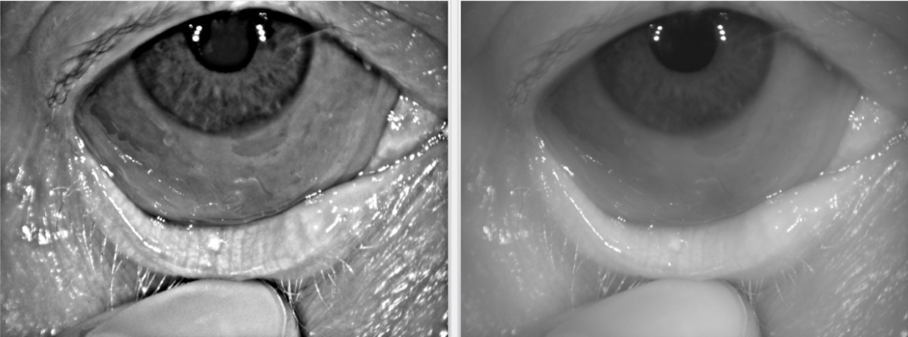
Blepharitis
Case Report 05 (OD) – Meibomian Glands – lower eyelid

Slide 47
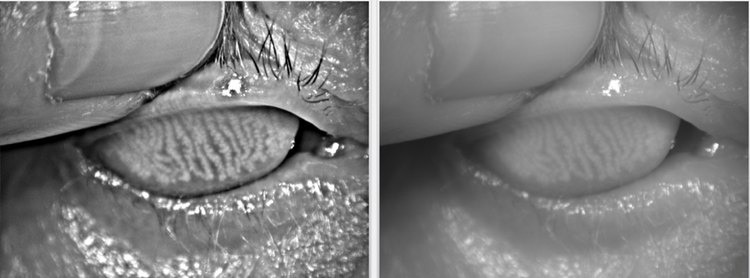
Blepharitis
Case Report 05 (OD) – Meibomian Glands – upper eyelid

Slide 48
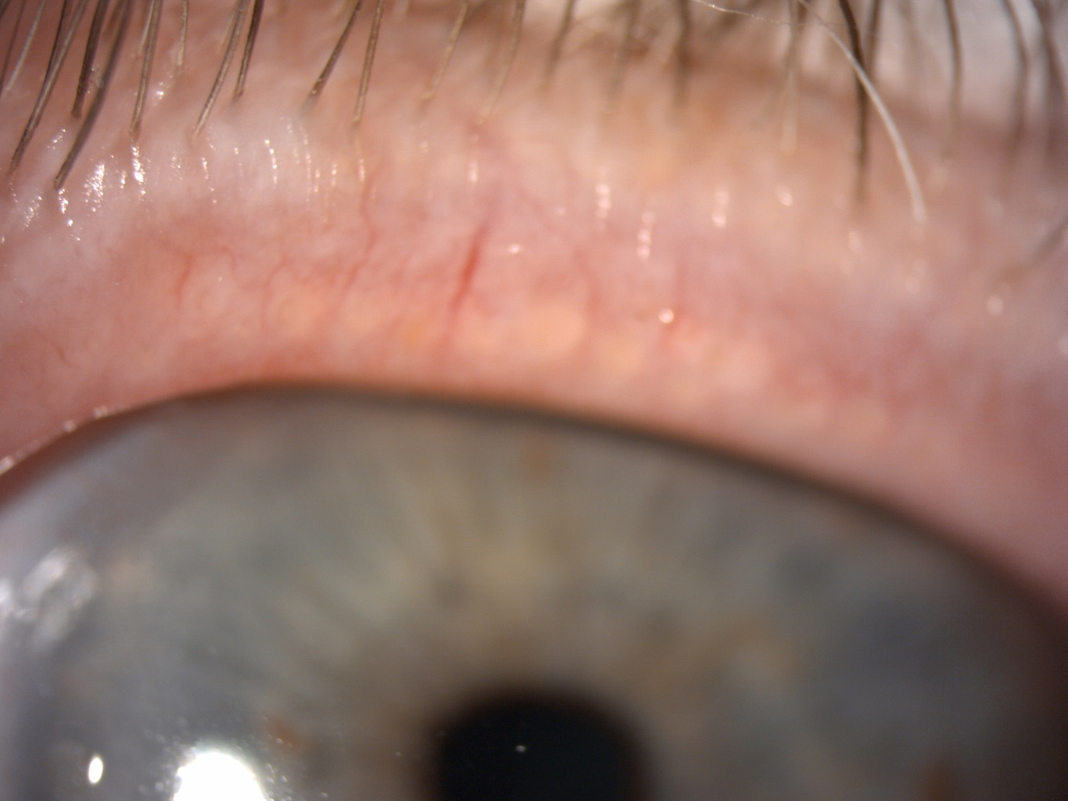
Blepharitis
Case Report 05 (OS) – Meibomian secretion before

Slide 49
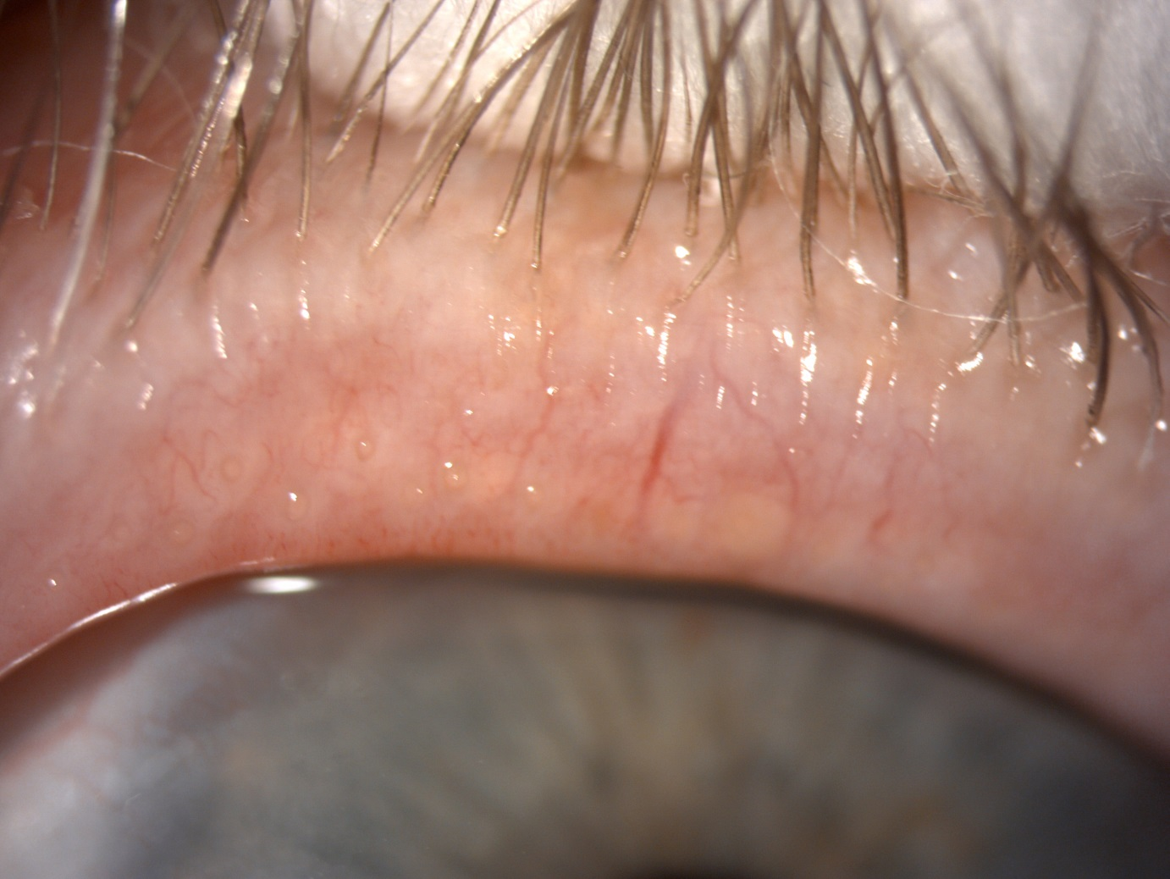
Blepharitis
Case Report 05 (OS) – Meibomian secretion after 14 days

Slide 50
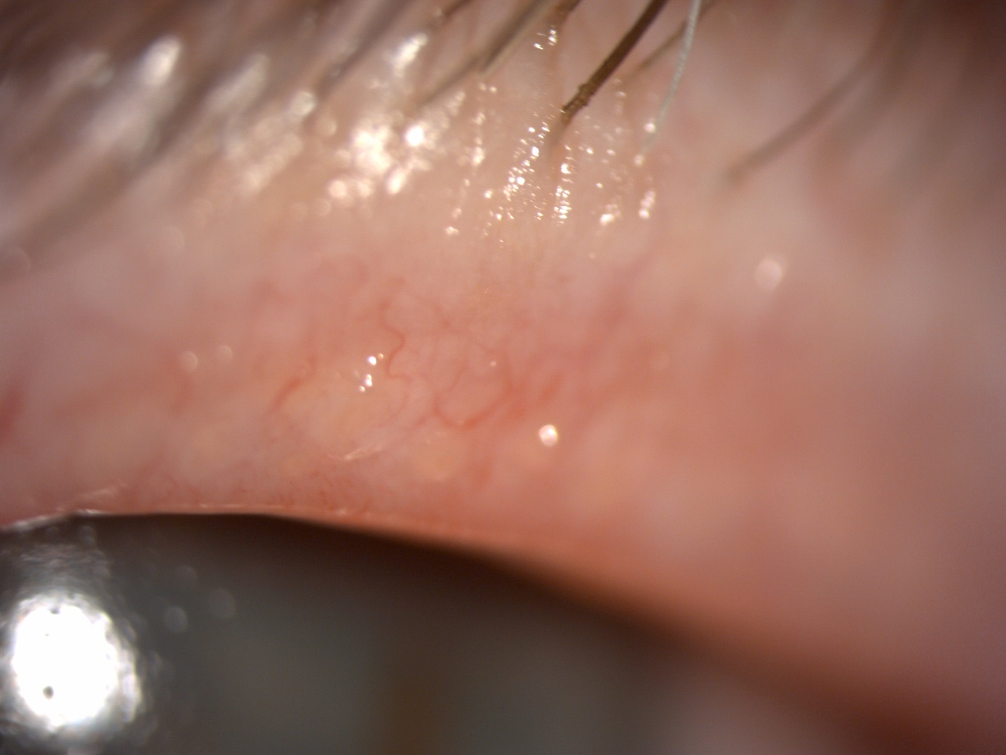
Blepharitis
Case Report 05 (OS) – Meibomian secretion after 1 month

Slide 51
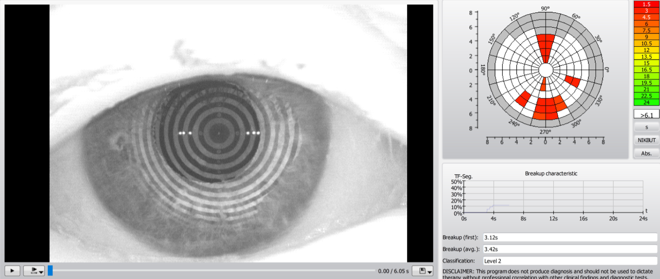
Blepharitis
Case Report 05 (OD) – Keratograph BUT – Before

Slide 52
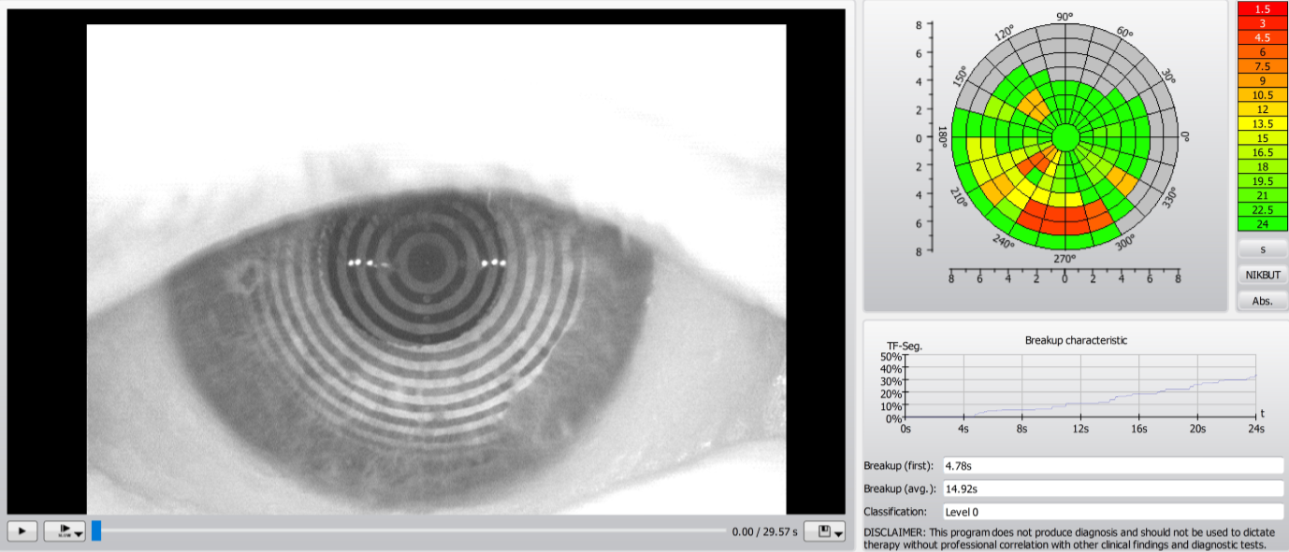
Blepharitis
Case Report 05 (OD) – Keratograph BUT – After 1 month

Slide 53
Blepharitis
Case Report 05 (OS) – Keratograph – Evaluation of treatment
 | PRE-EXAMINATION |  |  | 7 DAYS AFTER |  |  | 14 DAYS AFTER |  |  | MONTH AFTER
Teardrop height in 3 positions (tempor, middle, nasal)
L | 35 | 28 | 32 | 35 | 43 | 44 | 48 | 43 | 34 | 45 | 44 | 29
R | 33 | 38 | 33 | 33 | 50 | 54 | 34 | 40 | 0,43 | 36 | 38 | 47
BUT - tear film decay, total average
R | 11,18 |  |  | 9,87 |  |  | 10,24 |  |  | 15,3
L | 10,16 |  |  | 13,23 |  |  | 2,94 |  |  | 5,03
BUT - tear film decay, average
R | 6,94 |  |  | 4,14 |  |  | 2,65 |  |  | 3,05
L | 4,4 |  |  | 3,42 |  |  | 2,1 |  |  | 2,84
Lipid layer - thickness (the higher the better)
R | 13-15 |  |  | 13-15 |  |  | 30-50 |  |  | 13-15
L | 13-15 |  |  | 30-50 |  |  | 13-15 |  |  | 13-15
Redness of eyes - bulbal (temporal, nasal), limbal (temporal, nasal)
R | 1,8 2,0 |  | 1,5 2,0 | 1,7 2,0 |  | 1,2 1,8 | 1,6 1,1 |  | 1,0 0,6 | 1,4 1,0 |  | 1,1 0,6
L | 1,2 1,0 |  | 1,0 0,8 | 1,5 1,4 |  | 1,3 1,0 | 1,0 1,0 |  | 0,7 0,5 | 1,4 1,3 |  | 1,1 0,9
Meimbom. Glands - degree (0. healthy - 4. significant decrease)
R UPPER | 2 |  |  | 2 |  |  | 2 |  |  | 2
L UPPER | 2 |  |  | 2 |  |  | 2 |  |  | 2
R LOWER | 1 |  |  | 1 |  |  | 1 |  |  | 1
L LOWER | 2 |  |  | 2 |  |  | 2 |  |  | 2

Slide 54
Blepharitis
Case Report 05 (OS) – Keratograph – Evaluation of treatment
SLIT LAMP
 | PRE-EXAMINATION | PRE-EXAMINATION | 7 DAYS AFTER | 14 DAYS AFTER | MONTH AFTER
CONTROL EYELID AND SURROUNDING
L |  | eyes calm, without problem | eyes calm, without problem | eyes calm, without problem | on the lower L foaming - eyes calm, without problem
R
CLOSING THE EYELIDS
R |  | yes | yes | yes | yes
L |  | yes | yes | yes | yes
CONTROL OF EYELASHES - SEARCH, DISCOLORATION, ENTROPION, ECTROPION
R |  | no | no | no | no
L |  | no | no | no | no
PRESENCE OF DEMODEX - INTERVENTION SIZE
R |  | yes - a little | yes - a little | yes - a little | yes - a little
L |  | yes - a little | yes - a little | yes - a little | yes - a little
EXPRESIBILITY OF GLANDS - QUNTITY AND QUALITY
R |  | 1 | 1, improvement - clearer | 1, clear, big | 1, clear, big
L

Slide 55
Blepharitis
Case Report 06 (OD)
Woman, age 62 years
Anamnesis:
Meibomitis, Demodex (trial of new demodex therapy with colloidal silver)
Allergy:
Pollen, Sticking-plaster
Treatment:
1st control after 7 days
2nd control after 14 days
3rd control after 1 month after treatment (not yet)
Objective opinion:
The lipid layer was thinned
BUT also got worse
Possible effect of colloidal silver therapies on demodex???
Subjective opinion:
the patient is satisfied

Slide 56
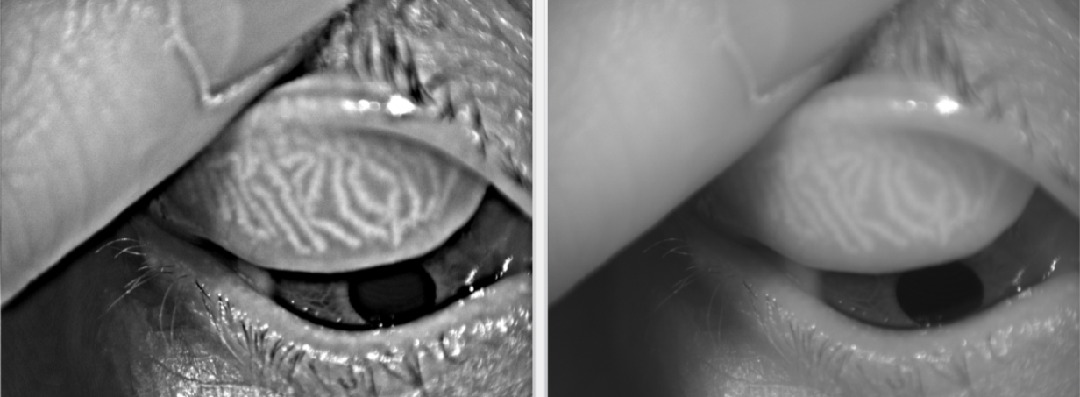
Blepharitis
Case Report 06 (OD) – Meibomian Glands – upper eyelid

Slide 57
Blepharitis
Case Report 06 (OD) – Meibomian Glands – lower eyelid

Slide 58
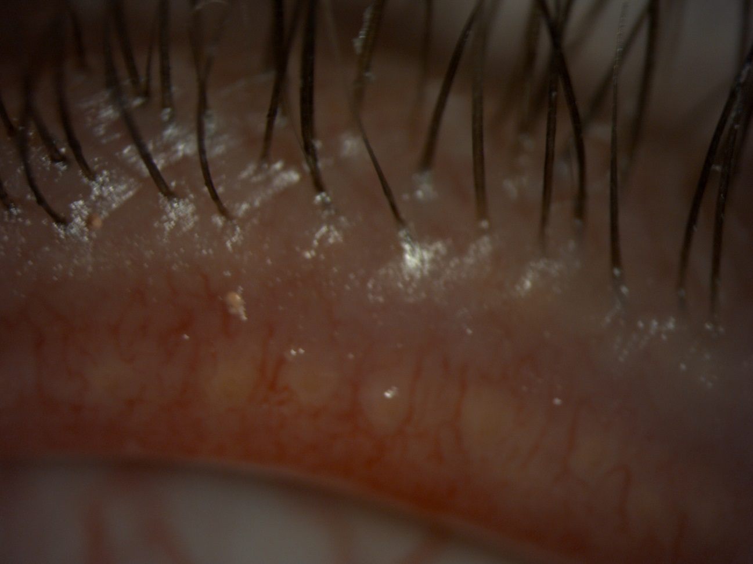
Blepharitis
Case Report 07 (OD) – Meibomian secretion before

Slide 59
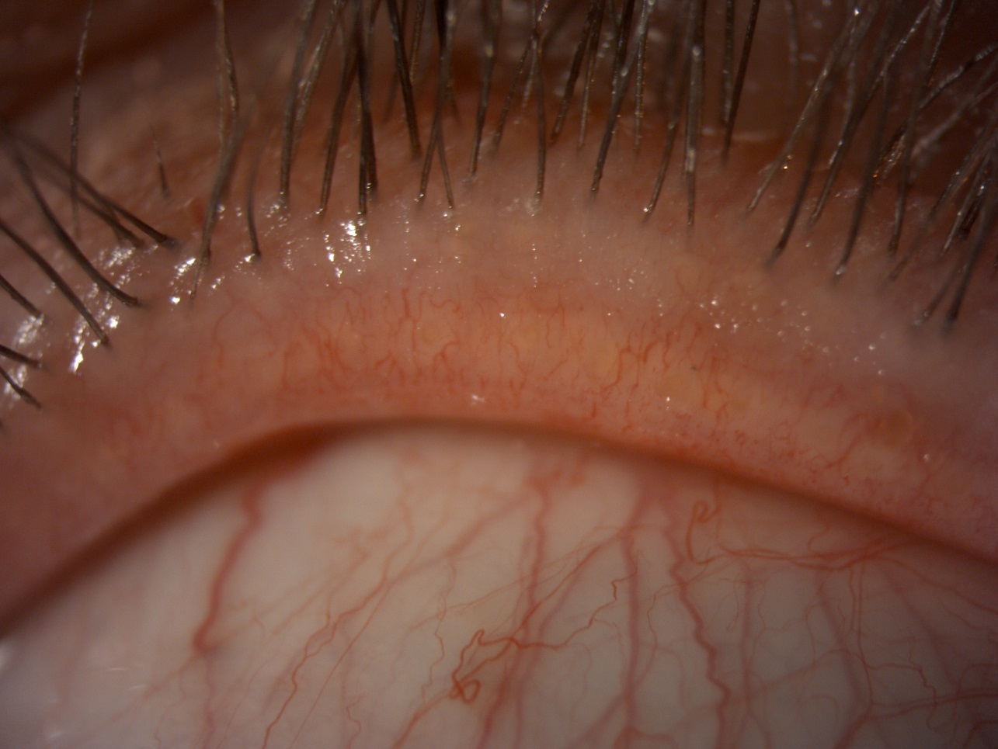
Blepharitis
Case Report 07 (OD) – Meibomian secretion after 7 days

Slide 60
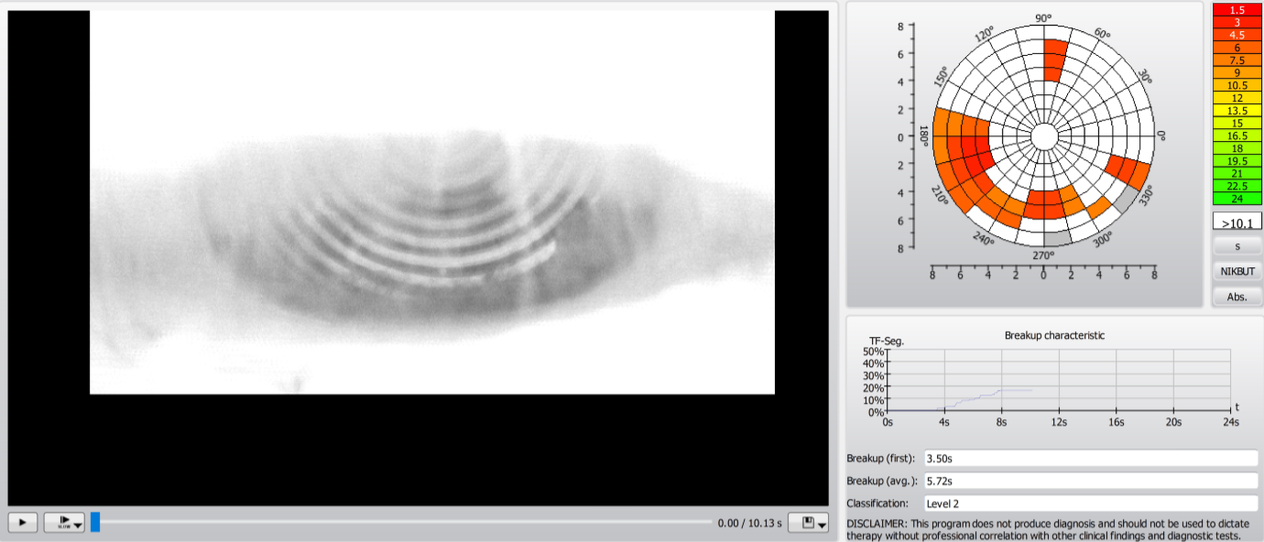
Blepharitis
Case Report 07 (OD) – Keratograph – Before

Slide 61
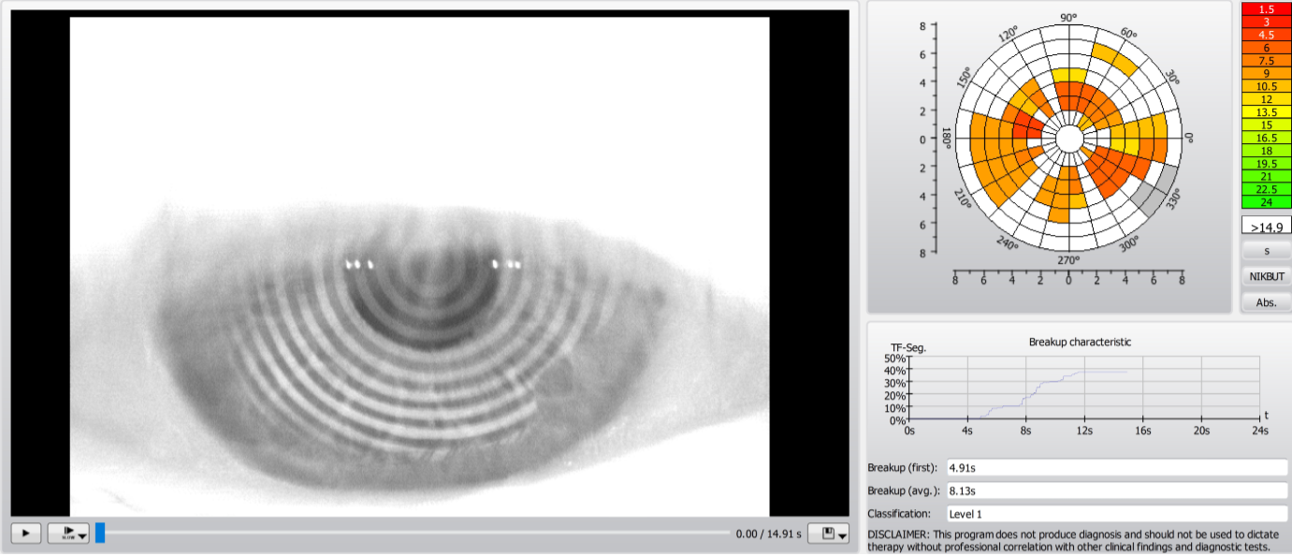
Blepharitis
Case Report 07 (OD) – Keratograph – After 14 days

Slide 62
Blepharitis
Case Report 07 (OD) – Keratograph – Evaluatioon of treatment
 | PRE-EXAMINATION |  |  | 7 DAYS AFTER |  |  | 14 DAYS AFTER |  |  | MONTH AFTER
Teardrop height in 3 positions (tempor, middle, nasal)
L | 42 | 29 | 36 | 26 | 25 | 35 | 0,36 | 0,34 | 0,66
R | 31 | 19 | 34 | 23 | 15 | 23 | 0,2 | 0,21 | 0,36
BUT - tear film decay, total average
R | 5,71 |  |  | 7,02 |  |  | 6,52
L | 5,1 |  |  | 6,86 |  |  | 5,44
BUT - tear film decay, average
R | 4,56 |  |  | 6,27 |  |  | 4,31
L | 3,44 |  |  | 2,8 |  |  | 2,72
Lipid layer - thickne (the higher the better)
R | 50-80 |  |  | 90-140 |  |  | 50-80
L | 50-80 |  |  | 90-140 |  |  | 50-80
Redness of eyes - bulbal (temporal, nasal), limbal (temporal, nasal)
R | 1,3 2,7 |  | 1,1 1,7 | 2,2 2,0 |  | 1,9 1,5 | 1,7 3,1 |  | 1,5 2,5
L | 1,1 1,4 |  | 0,9 0,8 | 1,1 1,3 |  | 1,0 0,8 | 1,4 2,3 |  | 1 1,1
Meimbom. Glands - degree (0. helthy - 4. significant decrease)
R UPPER | 1 |  |  | 1 |  |  | 1 |  |  | 1
L UPPER | 1 |  |  | 1 |  |  | 1 |  |  | 1
R LOWER | 1 |  |  | 1 |  |  | 1 |  |  | 1
L LOWER | 2 |  |  | 2 |  |  | 2 |  |  | 2

Slide 63
Blepharitis
Case Report 07 (OD) – Keratograph – Evaluation of treatment
SLIT LAMP
 | PRE-EXAMINATION | 7 DAYS AFTER | 14 DAYS AFTER | MONTH AFTER
CONTROL OF EYELID AND SURROUNDING
L | eyes calm, visible demodex | eyes calm, demodex | eyes calm, demodex. Therapy- coloidal silver
R
CLOTHING THE EYELIDS
R | yes | yes | yes
L | yes | yes | yes
CONTROL OF LASHES - SEARCH, DISCOLORATION, ENTROPION, ECTROPION
R | no | no | no
L | no | no | no
PRESENCE OF DEMODEX - INTERVENTION SIZE
R | yes - visible | yes - visible | yes
L | yes - visible | yes - visible | yes
EXPRESIBILITA OF GLANDS - QUANTITY AND QUALITY
R | 1- milky | yes - clerer than before | 1 clear
L

Slide 64
COMPEX, spol. s r. o.
A/ Palackeho tr. 924/105, 612 00 Brno, Czech Republic
E/ info@jett.eu
W W W . J E T T . E U

