Slide 1
Entropion
Treated by JETT PLASMA LIFT MEDICAL

Slide 2

Case
Patient, 70 years old
Entropion of the lower eyelid of the right eye
Patient was treated according to JETT protocol
Courtesy to MUDr. Marie Petrikovitsová, Military Hospital Brno, Czech Republic

Slide 3
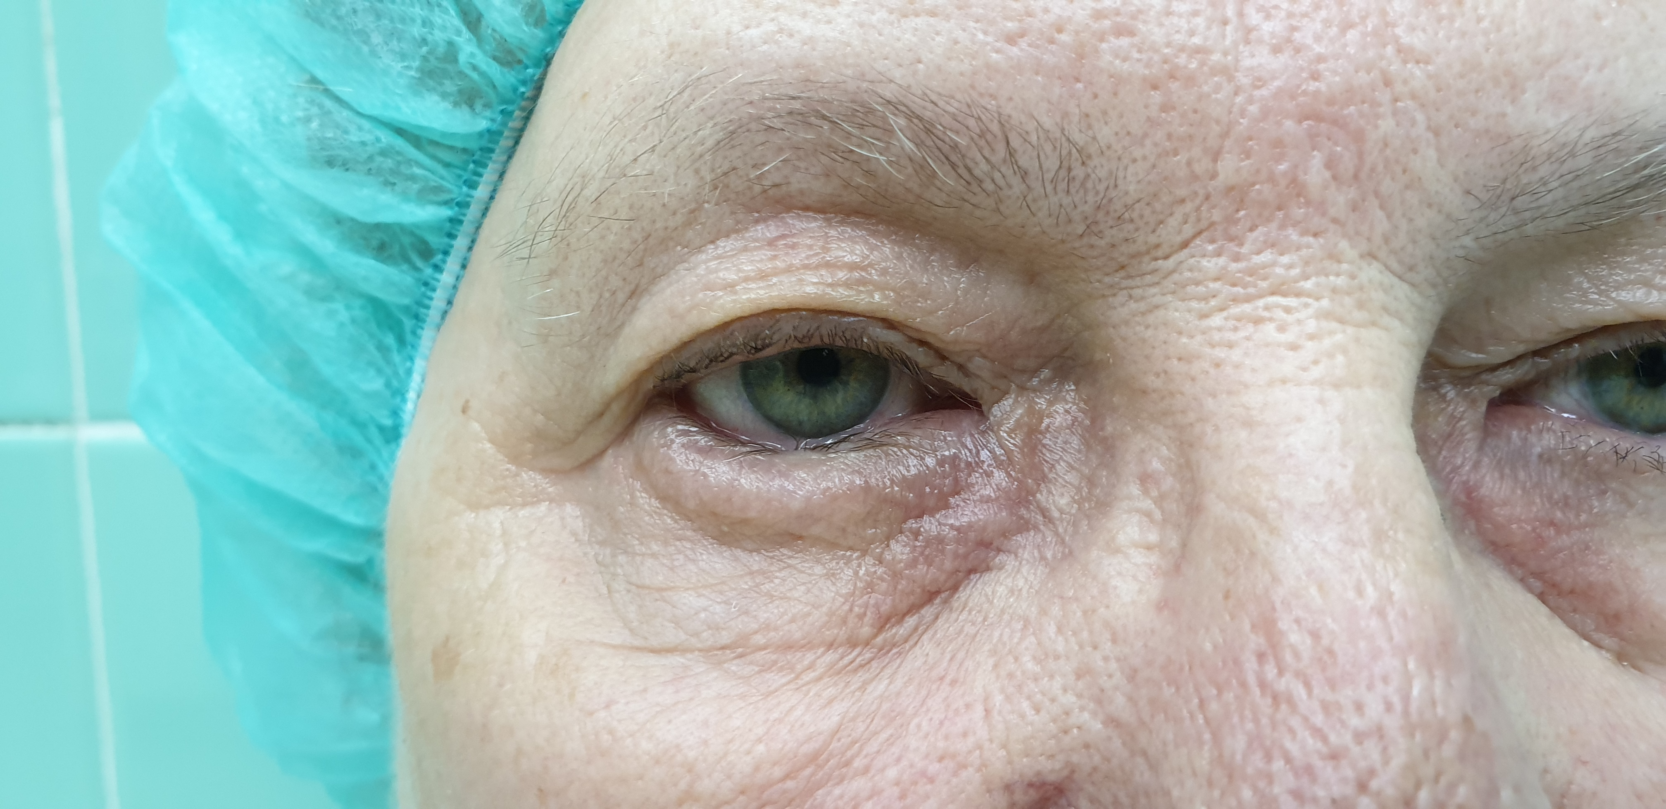
Before treatment

Slide 4
Before treatment

Slide 5
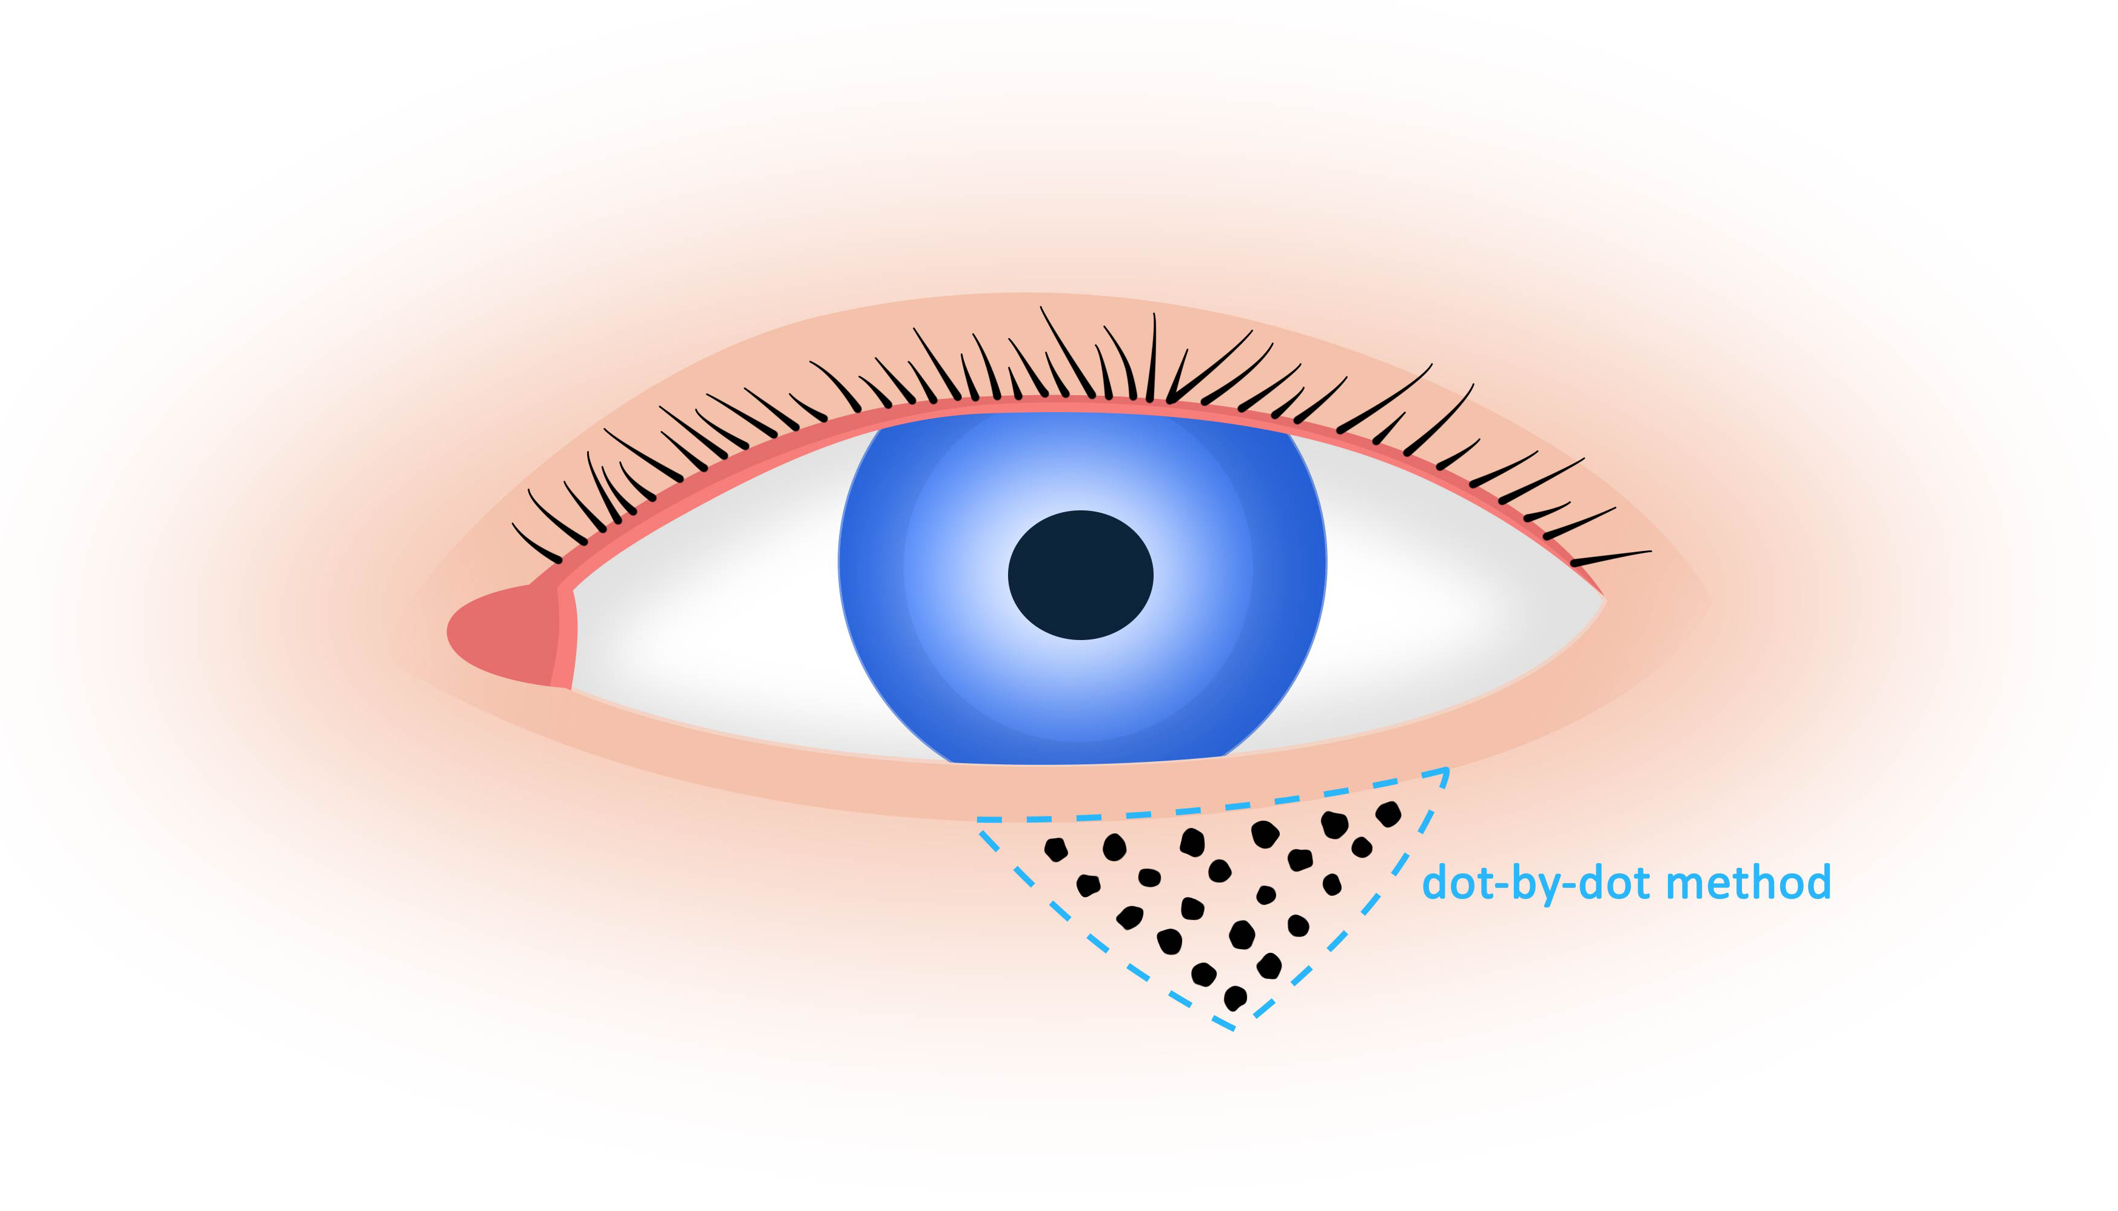
Treatment protocol

Slide 6
Treatment protocol
Treat the area with dot-by-dot method in the line below the algal margin and then mark the triangle points down from the edge of the lid
The recommended size of the treated area is 4-5mm from the edgeof the lid in a width of 4-5mm wide

Slide 7
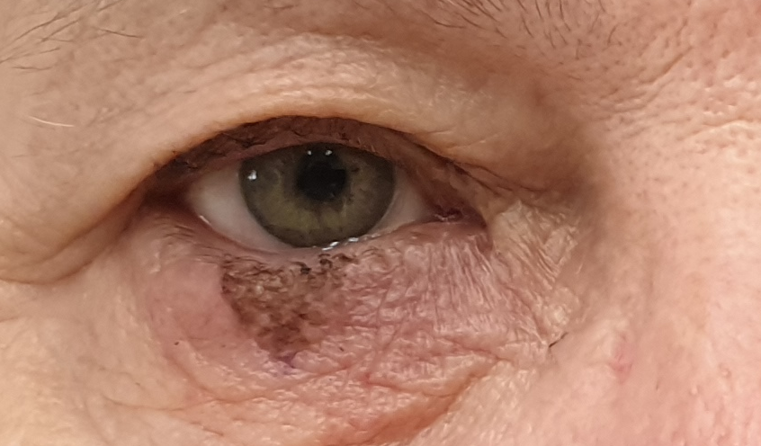
Immediately after

Slide 8
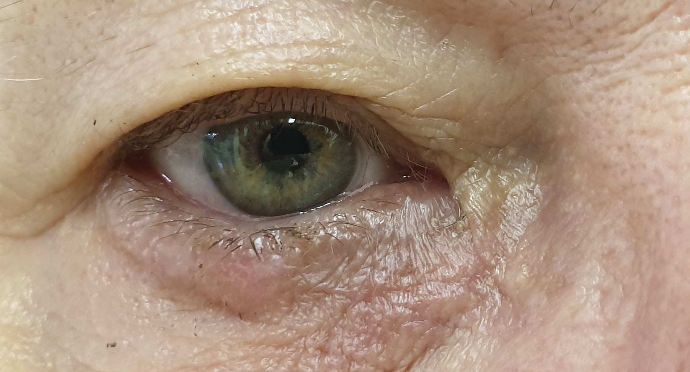
After 1 month

Slide 9
Check-ups
The doctor decided to invite the patient for check up´s:
2 days after treatment
1 month after tretment
Both, patient and doctor are very satisfied with the results!

Slide 10
COMPEX, spol. s r. o.
A/ Palackeho tr. 105, 612 00 Brno
E/ info@jett.eu
W W W . J E T T . E U

